Slide 1
Assessment of community resilience frameworks:
a validation through community outcomes
after disaster events
Project Team:
Maria Dillard¹, Michael Gerst¹, Tiffany Cousins¹, Donghwan Gu² (Presenter)
¹ Division 731 Materials and Structural Systems Division, Engineering Laboratory, National Institute of Standards and Technology, USA
² University of Maryland, College Park, MD, USA
SRA 2025
W2-A: Risk and Deep Uncertainty - Disasters and Stochasticity
December 10, 2025
Notes:
Title and authors
NIST and research team members
Research scientist in the Community Resilience Group at the National Institute of Standards and Technology (NIST).
Urban planner and social science researcher with civil engineering background.
-----------
Assessment of community resilience frameworks: a validation through community outcomes after disaster events
Wed, December 10 | 10:50 AM - 11:10 AM | River Birch Ballroom A
Part of:
W2-A: Risk and Deep Uncertainty - Disasters and Stochasticity 10:30 AM - 12:00 PM

Slide 2

Community Resilience Program
Multi-faceted research program assisting communities on issues related to buildings and infrastructure systems
2
Notes:
NIST manages the multi-faceted Community Resilience Program, assisting communities and stakeholders on issues related to buildings and infrastructure systems.
Interdisciplinary group of engineers and social scientists

Slide 3
Community Resilience
Community resilience is “the ability to prepare for anticipated hazards, adapt to changing conditions, and withstand and recover within a specified time frame from disruptions.” (The White House, 2013)
Activities, such as disaster preparedness—which includes prevention, protection, mitigation, response and recovery—are key steps to improving resilience.
The White House. 2013. “Presidential policy directive: Critical infrastructure security and resilience.” Accessed August 1, 2011. https://obamawhitehouse.archives.gov/the-press-office/2013/02/12/presidential-policy-directive-critical-infrastructure-security-and-resil.
https://www.nist.gov/community-resilience
Notes:
In terms of the definition of community resilience, we are focusing on what we can do, activities, such as …

Slide 4
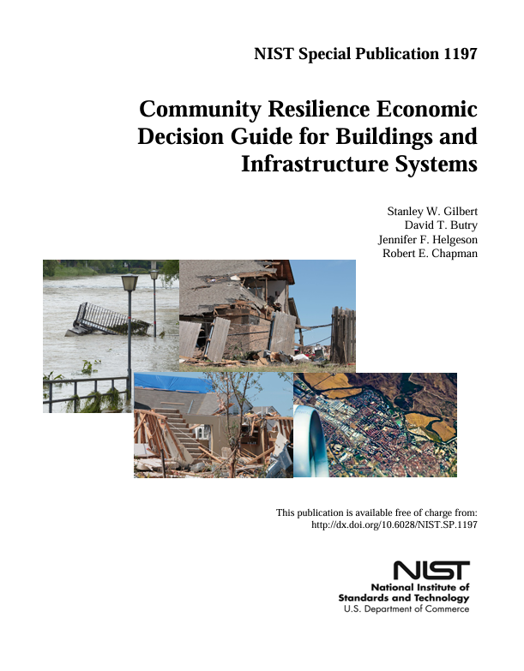

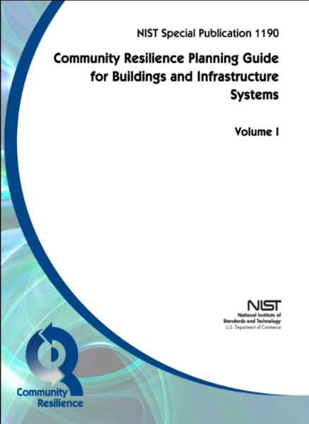

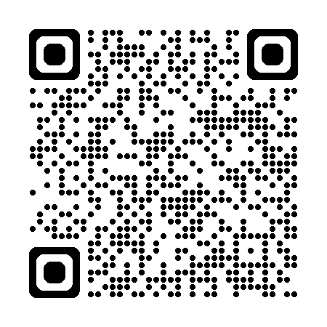
Community Resilience Program
2015
2020
2025
Alternatives for Resilient Communities (ARC)
Economic Decision Guide Software (EDGe$)
Further evolution of playbook
Community Resilience
Assessment Methodology
https://www.nist.gov/community-resilience
4
Notes:
This is an ongoing process. Community Resilience Planning Guide, playbook & multiple resilience planning tools.

Slide 5
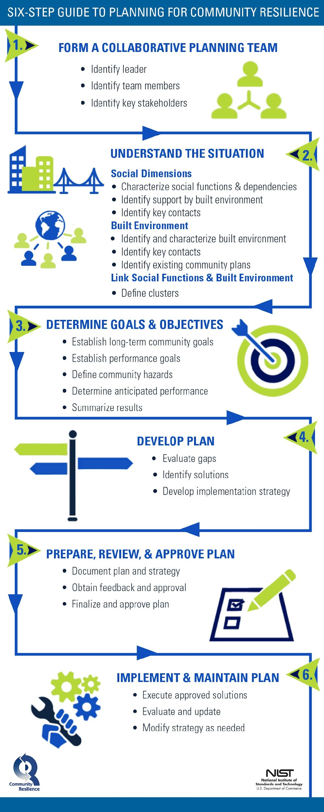
Community Resilience Indicators
Indicators are useful for measuring and evaluating complex systems.
Also useful for making decision maker and other parties’ goals, values, and beliefs explicit.
https://www.nist.gov/community-resilience/planning-guide/planning-guide-playbook-templates-additional-resources
Notes:
This is about the study target, community resilience indicators. Indicators are valuable for measuring and evaluating complex systems, such as community resilience.
Indicators involve almost all planning steps.

Slide 6

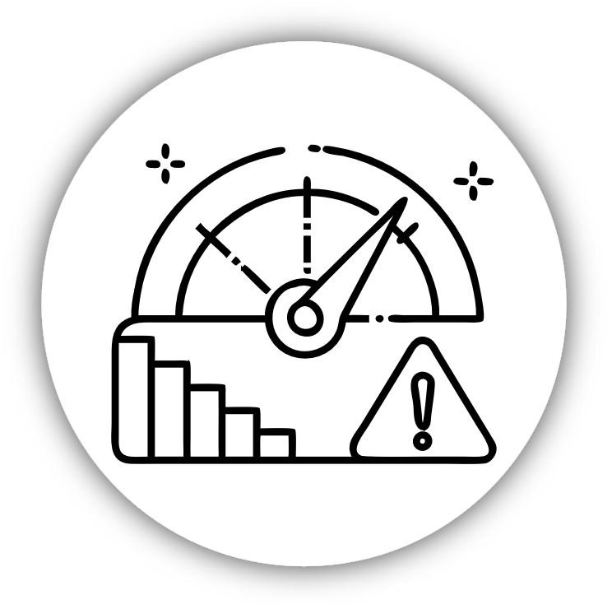

NIST Project on Community Resilience Assessment Methodology
To develop and disseminate
a database of county level community resilience indicators,
an inventory and analysis of published frameworks and indicators, and
scientifically grounded guidance necessary to quantitatively assess community resilience over time for the nation,
based on a suite of community resilience indicators that account for meaningful aspects of physical, social, and economic systems.
Notes:
-----
Systems-based Community Resilience Assessment Methodology –The final methodology will include the following: selected priority indicators, the analytical approach(es) for computing each indicator over time in a relevant manner for at least one spatial scale, best practices for how the approach can be replicated for different spatial scales, public data sources for all indicators, data visualization for the indicators via the NIST TraCR tool, multivariate analyses to examine relationships between indicators, sensitivity and uncertainty analysis, and validation studies.
https://www.nist.gov/community-resilience/products

Slide 7
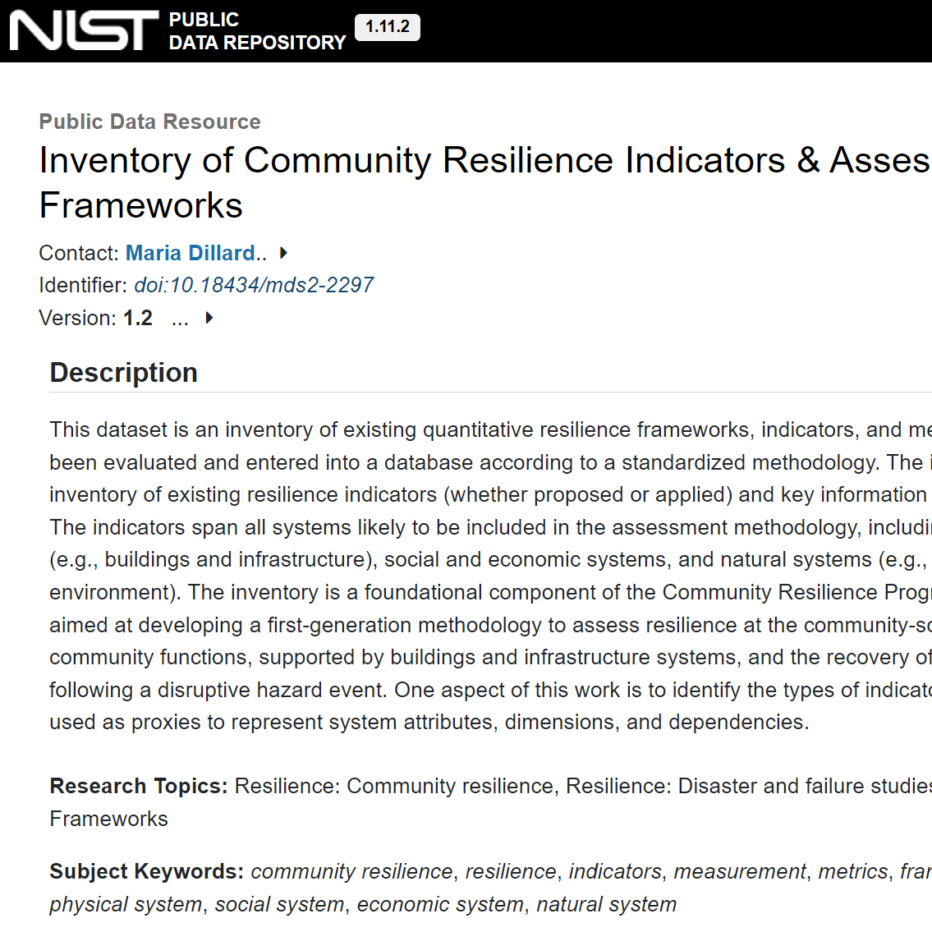
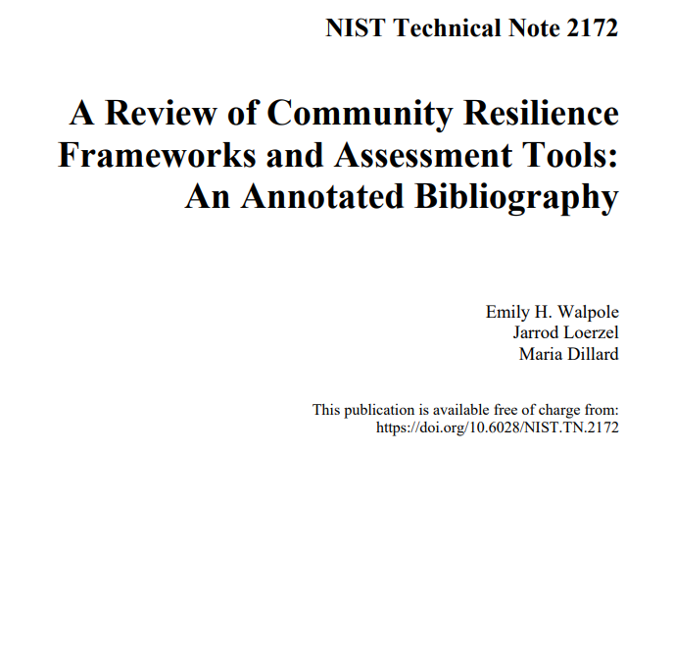
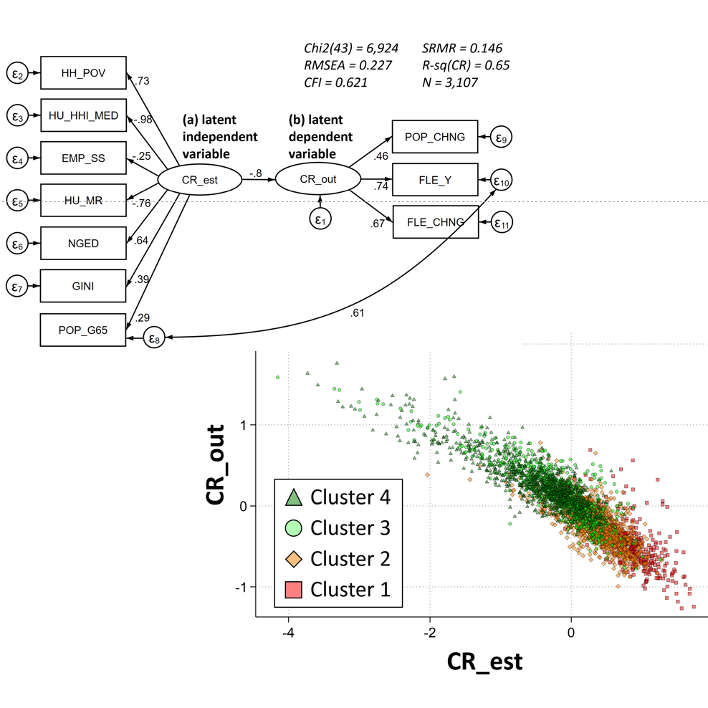
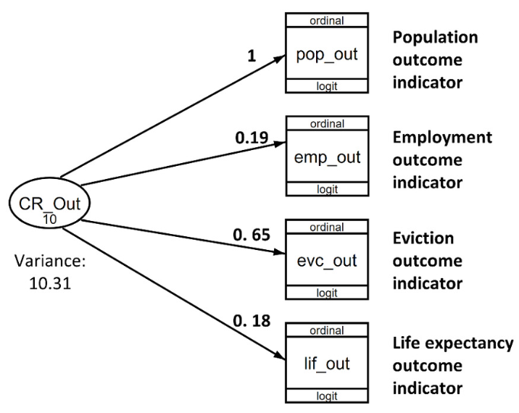
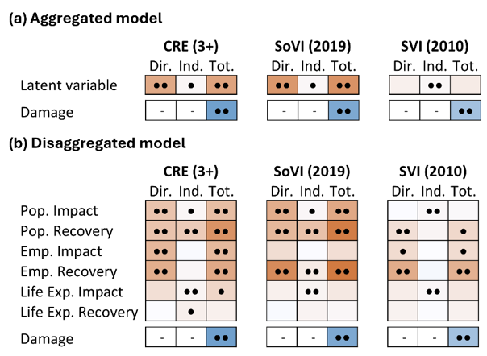
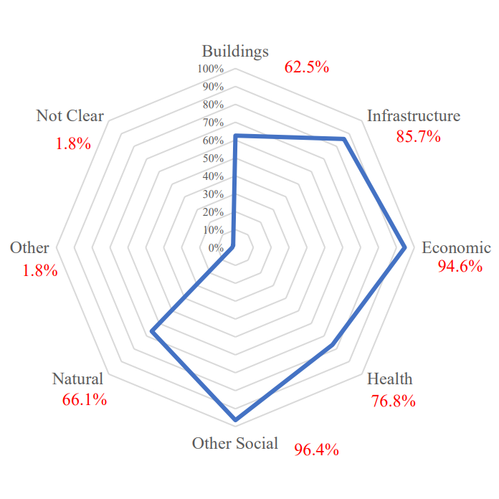
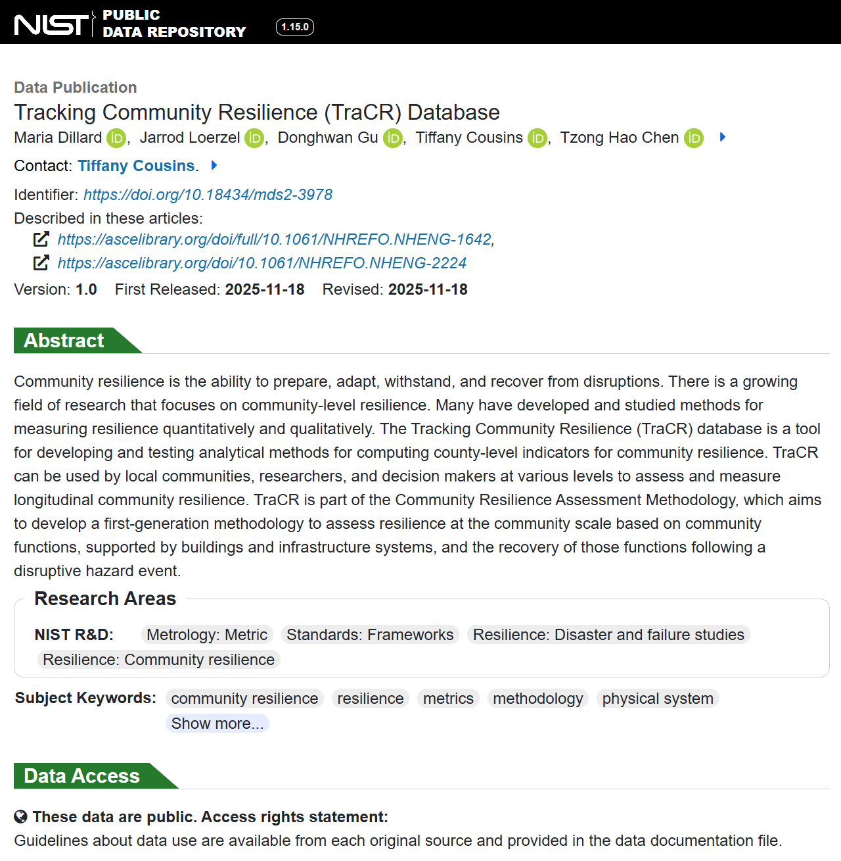
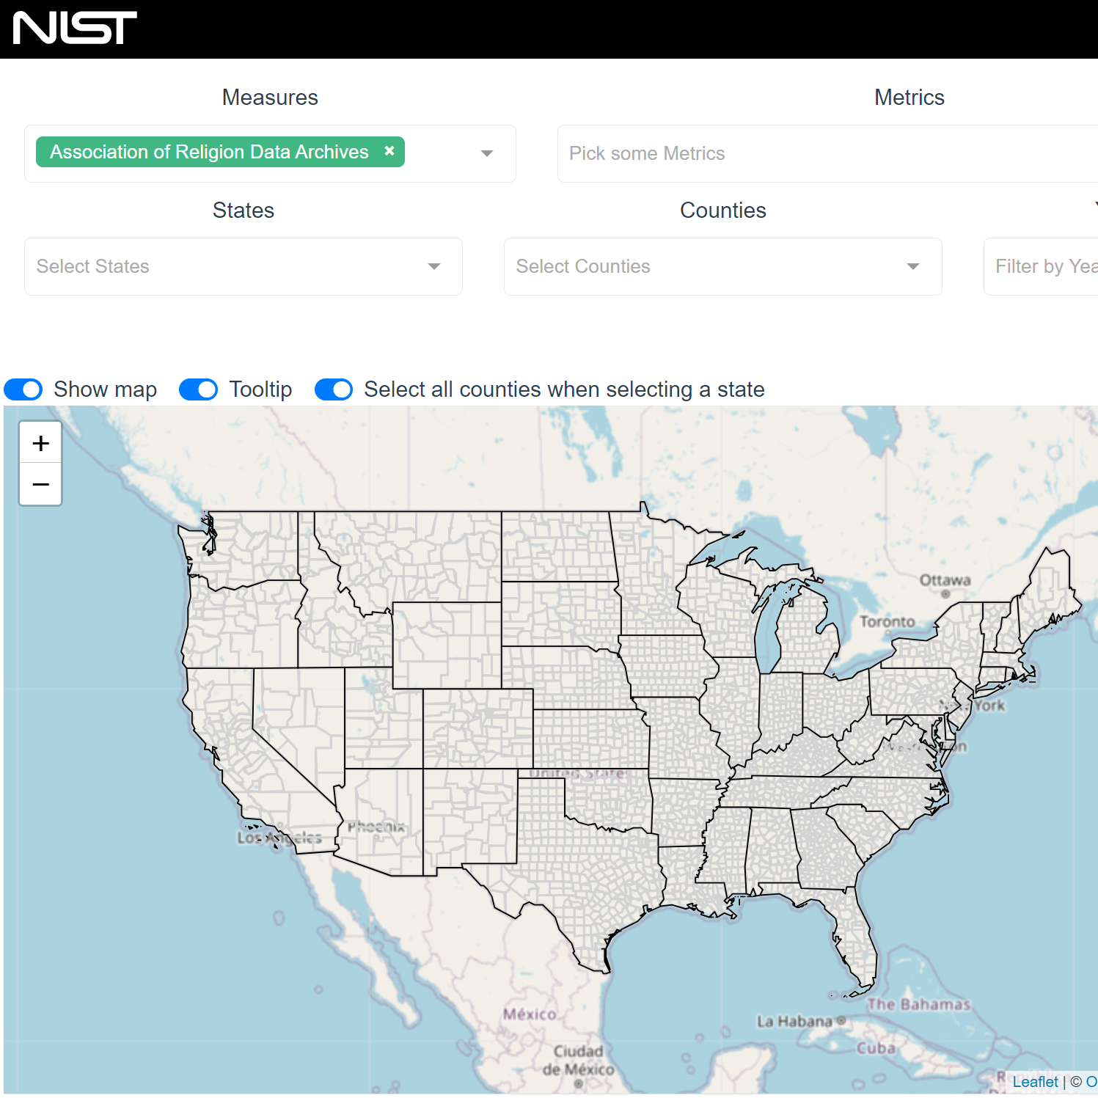
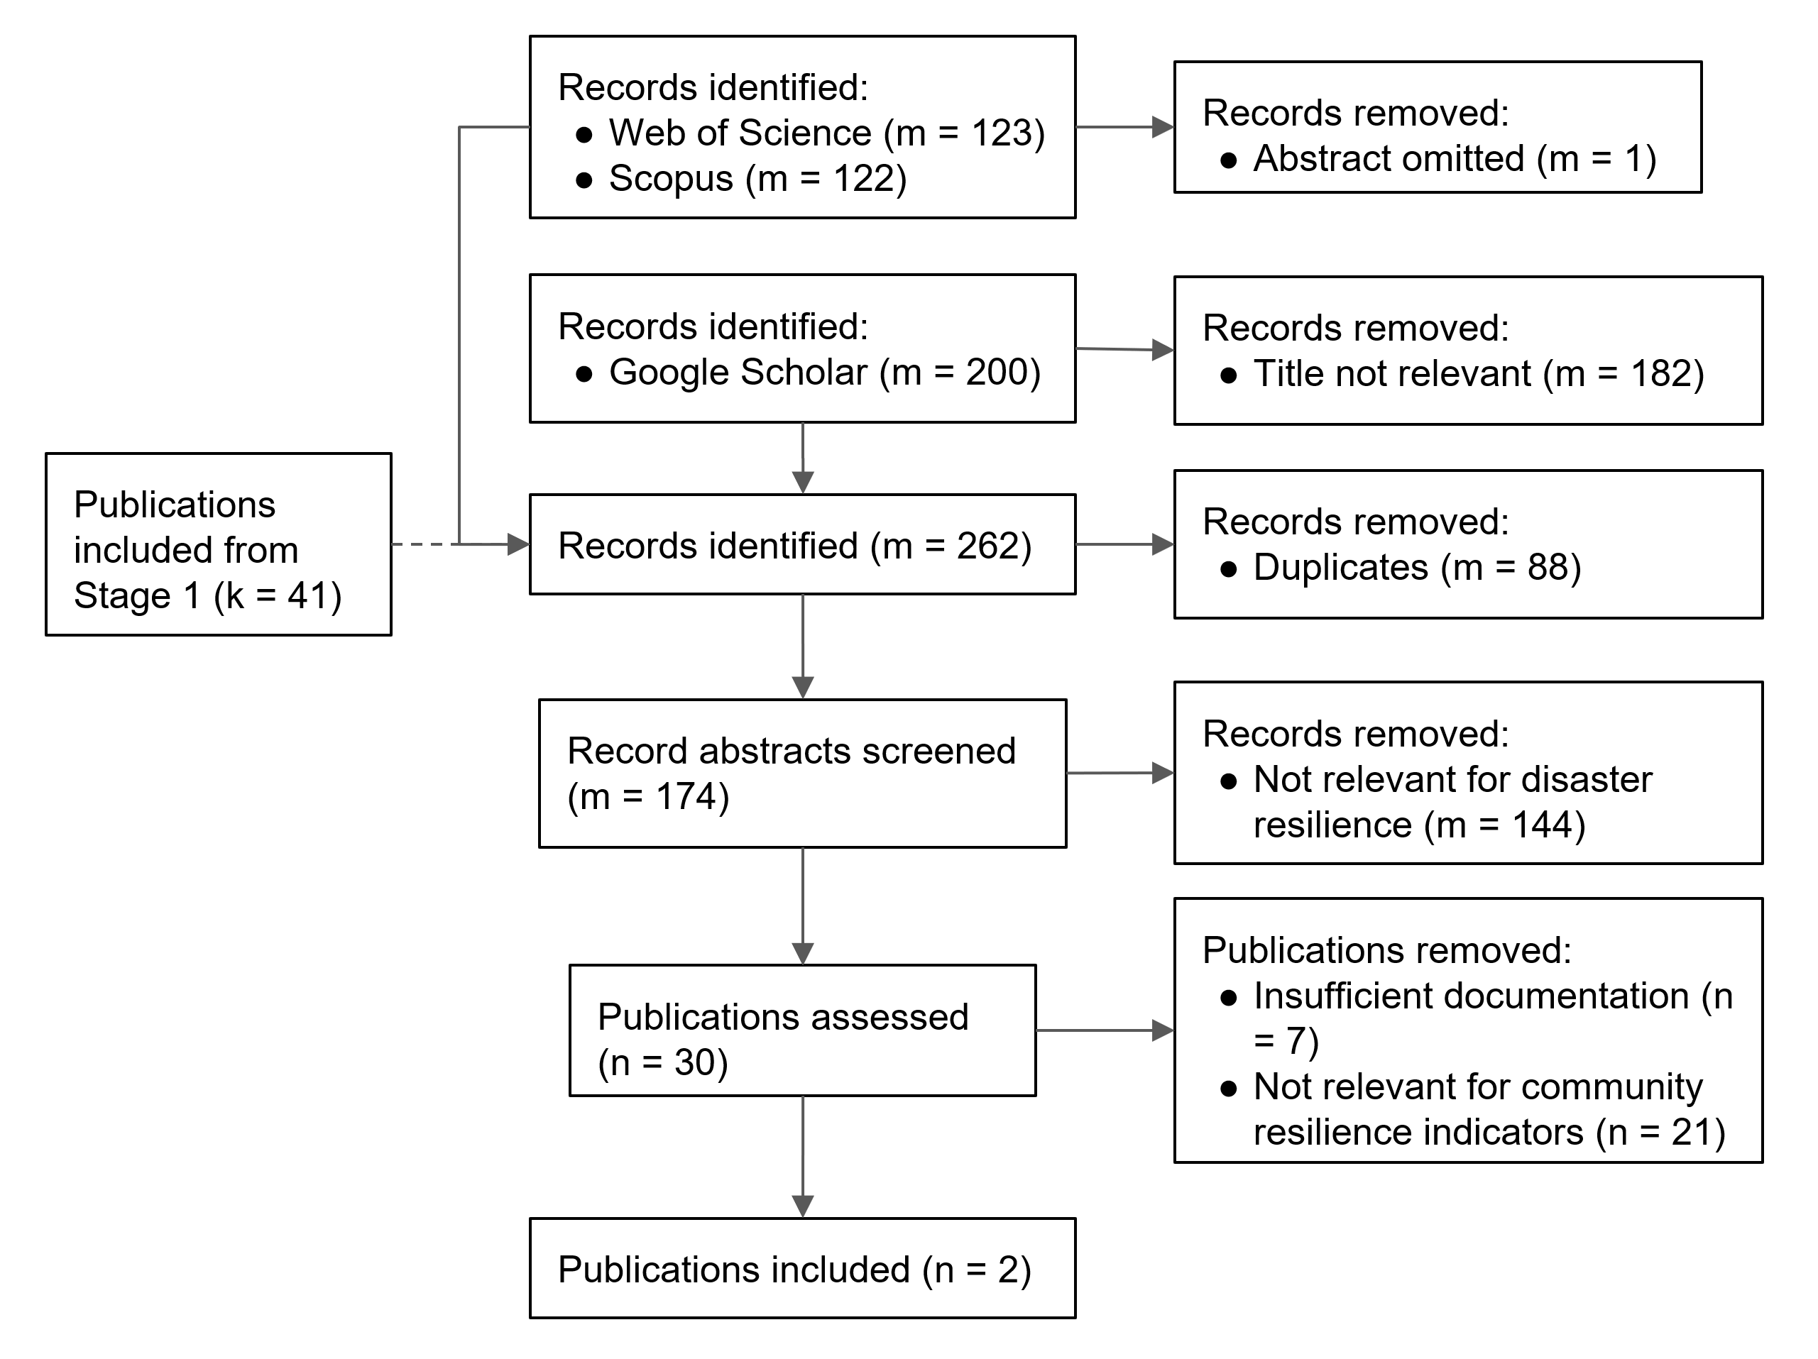
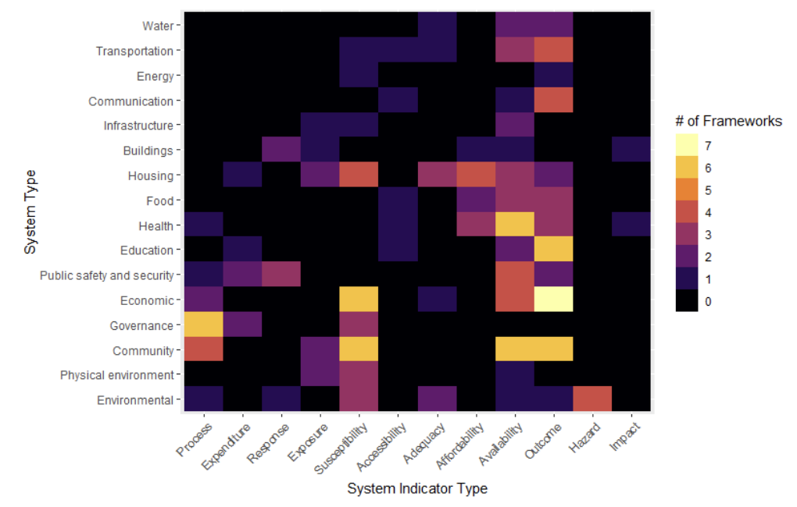
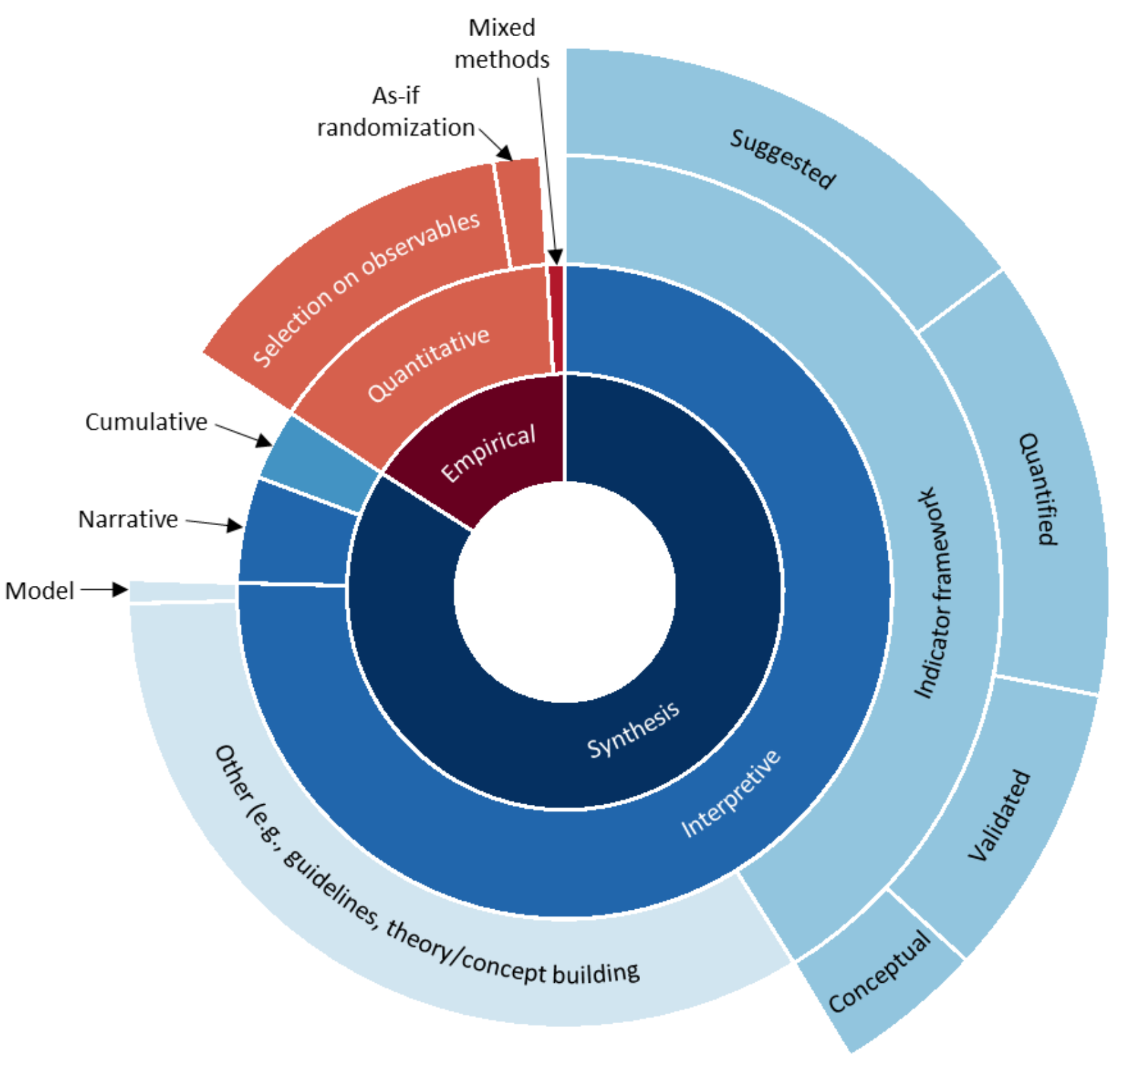
Overview of Assessment Methodology
Foundational Products
Criterion Validity
Indicator
Inventory
Annotated Bibliography
Construct Validity
Resilience
Outcomes
Predictive Indices
Indicator Selection and Validation
(Dillard, 2021)
(Walpole et al., 2021)
(Gu et al., 2023)
(Gu et al., 2025)
(Gu et al., 2026)
Translational Validity
Framework Data
TraCR
Database
TraCR
Interactive
Framework Analysis
Content
Validity
Indicator Taxonomy
Quality of
Evidence
(Loerzel et al., 2021)
(Dillard et al., 2025)
(Gerst et al., 2025)
(Gerst et al., 2024)
(Gerst et al., 2025)
In Progress
Completed

Slide 8
Research Infrastructure for
Community Resilience Measurement Science
Foundational Products
Criterion Validity
Indicator
Inventory
Annotated Bibliography
Construct Validity
Resilience
Outcomes
Predictive Indices
Indicator Selection and Validation
(Dillard, 2021)
(Walpole et al., 2021)
(Gu et al., 2023)
(Gu et al., 2025)
(Gu et al., 2026)
Translational Validity
Framework Data
TraCR
Database
TraCR
Interactive
Framework Analysis
Content
Validity
Indicator Taxonomy
Quality of
Evidence
(Loerzel et al., 2021)
(Dillard et al., 2025)
(Gerst et al., 2025)
(Gerst et al., 2024)
(Gerst et al., 2025)
In Progress
Completed
Notes:
Share two foundational items

Slide 9
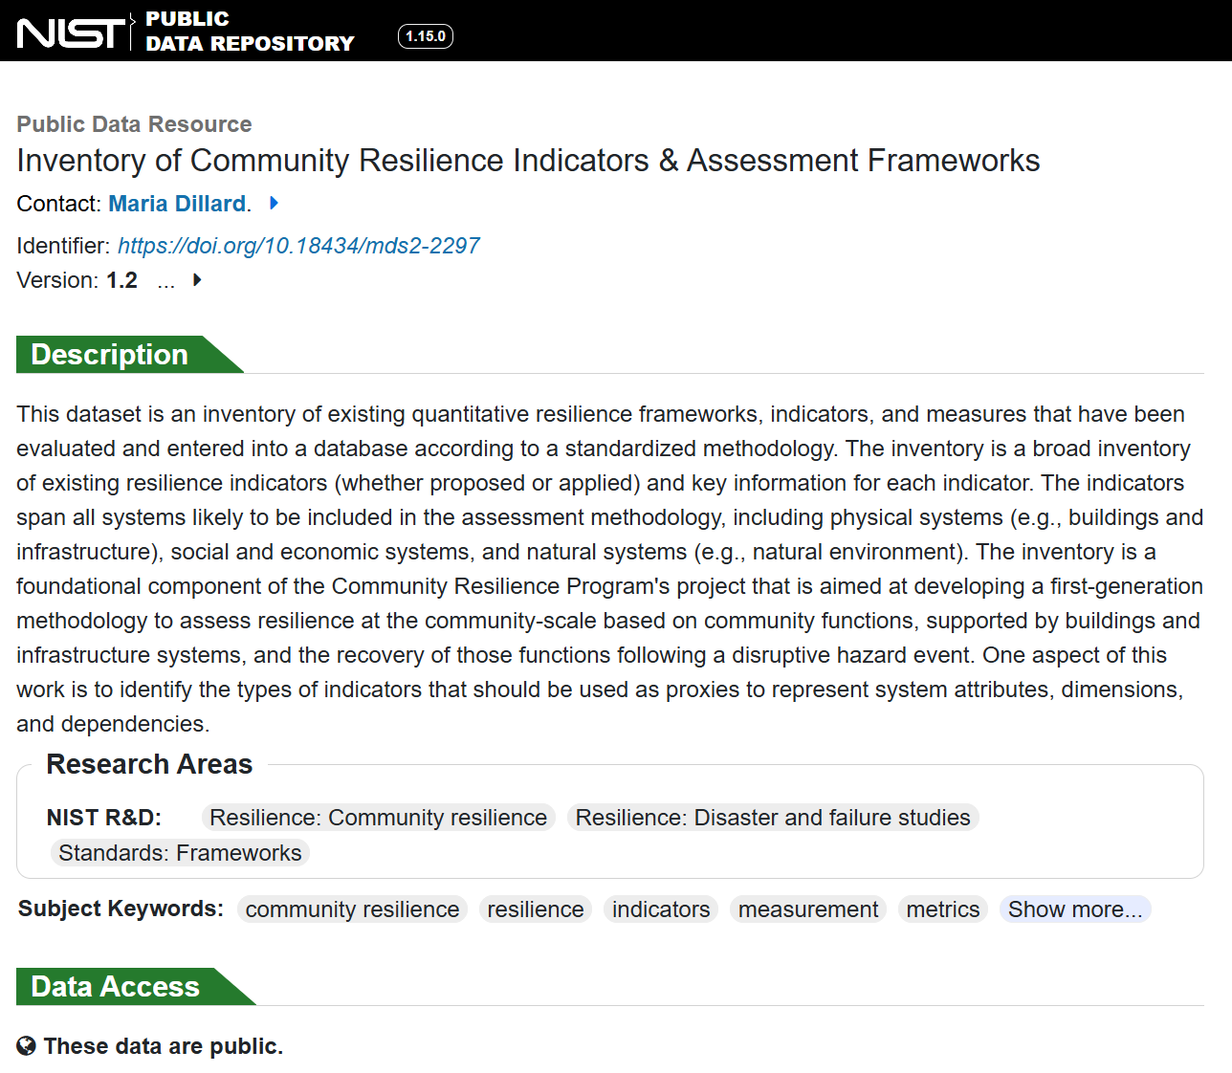
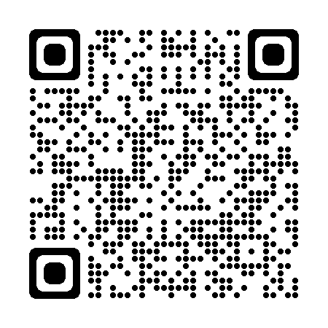
Inventory of Indicators
Inventory of Community Resilience Indicators & Assessment Frameworks includes indicators and measures from existing frameworks and methodologies
To identify consensus indicators for initial testing
To serve as a resource for researchers and communities searching
Contains 56 frameworks, 3,298 indicators, and 7,165 measures
https://data.nist.gov/od/id/mds2-2297
Notes:
-------------------
To identify consensus indicators, like what are the commonly used indicators
To serve as a resource for communities searching for other method

Slide 10
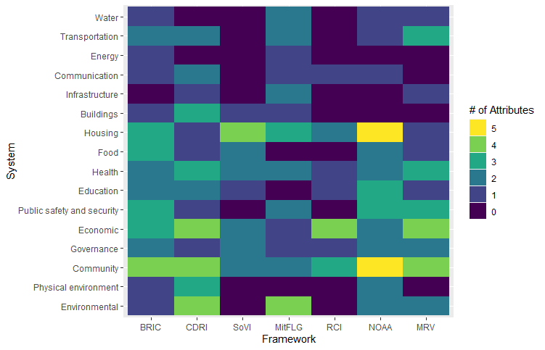
Indicators by Systems and Attributes
Frequency of attributes by framework and system
Missing!
Gerst, M., M. Dillard, E. Walpole, and J. Loerzel. 2024. A review of community resilience indicators using a systems measurement framework. Gaithersburg, MD: National Institute of Standards and Technology.
10
Notes:
how could we evaluate the indicators.
----------

Slide 11
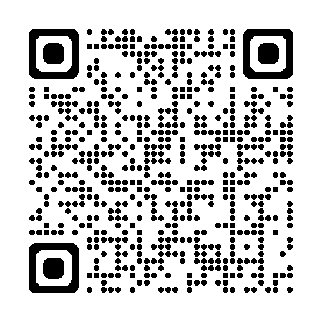
Tracking Community Resilience (TraCR)
TraCR Database V1.0
Database of existing and new indicators for social, economic, and physical systems
Foundational source for developing analytical methods for indicators
Unbalanced panel dataset containing 101 measures across 3,232 counties from 2000 to 2021
https://data.nist.gov/od/id/mds2-3978
Notes:
developed initially for NIST researchers as a sandbox for developing and testing community resilience measures.
----------
https://data.nist.gov/od/id/mds2-3978

Slide 12
Assessment Methodology - Validation
Foundational Products
Criterion Validity
Indicator
Inventory
Annotated Bibliography
Construct Validity
Resilience
Outcomes
Predictive Indices
Indicator Selection and Validation
(Dillard, 2021)
(Walpole et al., 2021)
(Gu et al., 2023)
(Gu et al., 2025)
(Gu et al., 2026)
Translational Validity
Framework Data
TraCR
Database
TraCR
Interactive
Framework Analysis
Content
Validity
Indicator Taxonomy
Quality of
Evidence
(Loerzel et al., 2021)
(Dillard et al., 2025)
(Gerst et al., 2025)
(Gerst et al., 2024)
(Gerst et al., 2025)
In Progress
Completed
Notes:
there are many community resilience indicators
the focus should be on developing a science-basis for assessment methodologies, validation of indicators.
there isn’t a lot of attention to validate these indicators, or validations are limited
the indicators increasingly being used to make bigger and bigger decisions
and potentially as it starts to become a component of grant funding criteria
-------------

Slide 13
Selection of Predictive Indices
Name | Source | Descriptionª
Community Resilience Estimate (CRE) | US Census Bureau (Bradatan et al., 2023; US Census, 2023, 2025a, 2025b) | Vulnerability index calculated as percent of population with “high social vulnerability”, which is defined as having three or more (out of 10) components of vulnerability (-)
Social Vulnerability Index (SoVI) | University of South Carolina Hazards Vulnerability and Resilience Institute (Cutter et al., 2003; SoVI 2016, 2025) | Vulnerability index calculated as a sum of factor values after directional adjustments derived from 29 indicators (-)
Social Vulnerability Index (SVI) | US Centers for Disease Control and Agency for Toxic Substances and Disease Registry (Flanagan et al., 2011; CDC/ATSDR 2015, 2024) | Vulnerability index calculated as the percentile ranking of 14 indicators aggregated into four categories (-)
Baseline Resilience Indicators for Communities (BRIC) | University of South Carolina Hazards Vulnerability and Resilience Institute (Cutter et al., 2014) | Resilience index composed of a sum of six subcategory scores constructed from 49 indicators (+)
National Risk Index (NRI) | US Federal Emergency Management Agency (FEMA, 2020a; Zuzak et al., 2022) | Risk index composed by multiplying expected annual loss across 18 hazard types (EAL), SVI, and the inverse of BRIC (-)
How do we select the indicators and measures?
How can we know that this framework is effective?
The validation method is applied to five predictive indices with U.S. county-level data.
a. A plus (+) or minus (-) at the end of the description indicates the expected direction the index will have with the resilience outcome construct and indicators.
Notes:
-----------
The validation method is applied to five predictive indices with U.S. county-level data (Table 1). The indices were chosen based on the authors’ expert knowledge of commonly used indices in the U.S. Three of the indices (Community Resilience Estimate (CRE), Social Vulnerability Index (SVI), and National Risk Index (NRI) are produced by various agencies of the U.S. federal government. The other two (Social Vulnerability Index (SoVI) and Baseline Resilience Indicators for Communities (BRIC)) are products of the University of South Carolina’s Hazards, Vulnerability, and Resilience Institute.

Slide 14
Reliability and criterion validation efforts
Extant literature
NIST research
P₁
Community resilience index measurement model reliability for a predictive validation
(Gu et al., 2025)
RBF₁
PF₁
B₁
Predictive index measurement
model reliability
P_{i}
RBI
PI
RBF_{n}
B_{n}
P₁
PF_{n}
P_{j}
P₁
P₁
Validation using damages
(concurrent)
or other index (convergent)
PF₁
Predictive validation and measurement model reliabilities
(Gu et al., 2023)
(Gu et al., 2026)
PF₁
RBF₁
P_{i}
P_{i}
B₁
PI
Damages
PI
RBI
P₁
P₁
RBF_{n}
B_{n}
PF_{n}
PF_{n}
P_{j}
P_{j}
P = predictive indicator, PF = predictive factor, PI = predictive index,
RBI = resilience baseline index, B = baseline indicator, RBF = resilience baseline factor
Notes:
a conceptual comparison of our indicator validation efforts to existing predictive indices and validation studies, shown in structural equation format.
The vertical dotted line delineates whether validation studies consider independent and dependent variables.
Many existing predictive indices focus on the reliability, or consistency of indicators
some validation efforts using damage or other physical disaster outcomes as a dependent variable.
the assumption here is a more resilient community should mitigate disaster damage.
---------
Row A: The preference for reliability assessments overshadows the empirical validation of indicators, which is crucial for ensuring the credibility of community resilience frameworks.
Row B and C: Previous disaster-induced community resilience studies tested a type of criterion validity through multivariate regression models using a small set of dependent variables measuring disaster damage and losses (Row B), and comparing composite and latent variables (Row C). The baseline assumption is that communities with high-level resilience are able to mitigate negative impacts, such as damage to buildings and fatalities, from disaster events.
Row D: The current study proposes a process to select and test longitudinal community outcomes as potential dependent (i.e., benchmark) variables adopting operationalization methods used in regional economic resilience studies.

Slide 15
Reliability and criterion validation efforts
Extant literature
NIST research
P₁
Community resilience index measurement model reliability for a predictive validation
(Gu et al., 2025)
RBF₁
PF₁
B₁
Predictive index measurement
model reliability
P_{i}
RBI
PI
RBF_{n}
B_{n}
P₁
PF_{n}
P_{j}
Outcome Indicator
P₁
P₁
Validation using damages
(concurrent)
or other index (convergent)
PF₁
Predictive validation and measurement model reliabilities
(Gu et al., 2023)
(Gu et al., 2026)
PF₁
RBF₁
P_{i}
P_{i}
B₁
PI
Damages
PI
RBI
P₁
P₁
RBF_{n}
B_{n}
PF_{n}
PF_{n}
P_{j}
P_{j}
P = predictive indicator, PF = predictive factor, PI = predictive index,
RBI = resilience baseline index, B = baseline indicator, RBF = resilience baseline factor
Notes:
look into the predictive validity of indicators, whether a predictive index can actually predict longitudinal community outcomes, as a dependent variable.
something to compare with the existing predictive indices.
--------------

Slide 16
Outcome Indicator
Two outcome indicator designs to include the time-dependent nature of resilience
Initial impact (%) = ((b) - (a)) / (b) * 100
Recovery (%) = ((c) - (b)) / (b) * 100
Recovery
Initial Impact
Notes:
conceptual design of the outcome indicator, including the time dependent nature of resilience.
two and five pre- and post-event periods.
The initial impact indicator measures the difference between the values recorded before the event and those recorded immediately after the event.
The recovery indicator measures the difference between the first post-event value and those recorded at the end of the post-event period.
Both outcome indicators are positive; this means that higher values signify better mitigation of initial impacts and a better recovery.
--------------
Regional economic resilience studies: continuous outcome indicators.

Slide 17
Outcome Indicator
Indicator | Outcome measure | Distributionª | Sensitivity to damage^{b} | Sensitivity to pop. density^{b} | Sensitivity to pre-event trend^{b}
Population | Population: Impact | ◆ | ● | ●● | ●●
 | Population: Recovery | ◆ | ● | ●● | ●●
 | Domestic migration rate: Impact
 | Domestic migration rate: Recovery
Economy | Labor force: Impact | ◆ |  | ● | ●●
 | Labor force: Recovery | ⬩ |  | ●●
 | Employment: Impact | ◆ |  | ● | ●●
 | Employment: Recovery | ⬩ |  | ●
 | Unemployment rate: Impact | ◆ |  |  | ●●
 | Unemployment rate: Recovery | ◆ |  | ○ | ○○
 | Income (Census): Impact | ◆
 | Income (Census): Recovery | ◆ | ○ | ○○
 | Income (BEA): Impact | ◆ |  | ○ | ●●
 | Income (BEA): Recovery | ⬩ |  | ○
 | Real GDP: Impact | ◆ |  |  | ●●
 | Real GDP: Recovery |  |  | ○
Livelihood | Poverty rate: Impact | ◆
 | Poverty rate: Recovery | ◆ | ○ | ○○
 | SNAP participation rate: Impact | ◆ | ○ | ○ | ●●
 | SNAP participation rate: Recovery | ◆ |  | ○○
 | Eviction threatened rate: Impact | ⬩ |  | ○
 | Eviction threatened rate: Recovery
Health | Obesity rate: Impact | ◆
 | Obesity rate: Recovery | ◆ |  |  | ○○
 | Physical inactivity rate: Impact | ◆
 | Physical inactivity rate: Recovery | ◆
 | Life expectancy: Impact | ◆ | ● | ●● | ●
 | Life expectancy: Recovery | ◆ |  | ●● | ●
Screening criteria: acceptable distribution and sensitivity to events and community characteristics
Measures with good statistical properties
Measures with expected relationships, such as
the sensitivity of each indicator to event occurrence and community characteristics
Selected: population, employment, and life expectancy outcome indicators
a. Distribution: A large diamond (◆) indicates that a variable has an acceptable distribution, with a skewness absolute value below 3 and a kurtosis below 20. A small diamond (⬩) also denotes an acceptable distribution, but with slightly more relaxed criteria: a skewness absolute value below 6 and a kurtosis below 40.
b. Sensitivity: A filled circle (●) denotes coefficients with the anticipated sign and a small effect size, where the absolute value is between 0.1 and 0.2. A double filled circle (●●) denotes coefficients with the anticipated sign and a medium or larger effect size, with an absolute value of 0.2 or higher. Conversely, coefficients with the opposite sign are marked with an empty circle (○) and a double empty circle (○○).
Notes:
tested multiple sets of outcome indicators and selected three indicators based on their statistical properties and sensitivity to disaster events and community characteristics.
-----------------

Slide 18
Reliability and criterion validation efforts
Extant literature
NIST research
P₁
Community resilience index measurement model reliability for a predictive validation
(Gu et al., 2025)
RBF₁
PF₁
B₁
Predictive index measurement
model reliability
P_{i}
RBI
PI
RBF_{n}
B_{n}
P₁
PF_{n}
P_{j}
SEM
P₁
P₁
Validation using damages
(concurrent)
or other index (convergent)
PF₁
Predictive validation and measurement model reliabilities
(Gu et al., 2023)
(Gu et al., 2026)
PF₁
RBF₁
P_{i}
P_{i}
B₁
PI
Damages
PI
RBI
P₁
P₁
RBF_{n}
B_{n}
PF_{n}
PF_{n}
P_{j}
P_{j}
SEM allows for simultaneous estimation of measurement models and multiple structural relationships.
P = predictive indicator, PF = predictive factor, PI = predictive index,
RBI = resilience baseline index, B = baseline indicator, RBF = resilience baseline factor
Notes:
the validity assessment of predictive indices.
Structural equation modeling allows combining these outcome indicators into a hypothetical construct

Slide 19
Validation Approach
Two complementary SEM strategies
      Aggregated model:
      single-construct, multi-indicator measurement model, which embodies the simplest possible interpretation
      Disaggregated model:
      maximally disaggregated model, also including lagged and cross-lagged relationships
Notes:
Two complementary modeling strategies
the connections between the predictive indicator and outcome indicators
Direct and indirect effects; the predictive indicator and damage
----------------------
This study sees these two strategies as complementary. If both show significant relationships, then there is firmer evidence for a predictive index being validated. Likewise, if both show nonsignificant or significance in an unexpected direction, then there is firmer evidence for a predictive index not being validated. Finally, if mixed results are observed, then comparisons between approaches may illuminate reasons for a lack of robust validation.
Both models include the control variables that were used as the criteria for selecting outcome indicators (i.e., pre-event slope, population density, and damages) to adjust for potentially confounding factors that could lead to spurious results between predictive and outcome indicators.
-----------
Rather than choose one SEM structure, this study compares a spectrum of SEMs with widely varying strategies for accounting for time and formulation.
On one end of the spectrum is the single-construct, multi-indicator measurement model, which embodies the simplest possible interpretation of this study’s resilience definition. On the other end is the maximally disaggregated model, where each indicator is assumed to perfectly measure its own construct.
Lagged and cross-lagged relationships are assumed to exist between impacts and recovery outcome indicators, as impacts precede recovery. In addition, as is standard practice for longitudinal SEMs, within-time relationships are captured by correlating impact indicator error terms and separately correlating recovery indicator error terms (Wheaton et al., 1977; Newsom, 2015).

Slide 20
Validation Results
The effect of the predictive indices on the outcome indicators can deviate from expectations based on their theoretical design.
Significant coefficients with anticipated signs are indicated by a filled circle, ●, for p < 0.05 and a double filled circle, ●●, for p < 0.01; significant coefficients with opposite signs are indicated by an empty circle, ○, for p < 0.05 and a double empty circle, ○○, for p < 0.01.
Notes:
A stronger degree of validity is observed in CRE and SoVI, a medium degree in SVI.
Indices with mixed results are BRIC and NRI.

Slide 21
Validation Results
Predictive indices are significantly related to damages in expected directions.
Significant coefficients with anticipated signs are indicated by a filled circle, ●, for p < 0.05 and a double filled circle, ●●, for p < 0.01; significant coefficients with opposite signs are indicated by an empty circle, ○, for p < 0.05 and a double empty circle, ○○, for p < 0.01.
Notes:
The results are consistent with the existing validation studies.

Slide 22
Validation Results
Testing adequacy of the suggested predictive index categories:
For an index to be adequate as a filter, its suggested categories should make distinctive predictions from adjacent categories.
Notes:
Estimated community resilience outcomes.
CRE uses too many categories to be adequate, as prediction errors overlap across categories.
The relatively coarse discretization used in SoVI yields distinctive predictions
---------

Slide 23
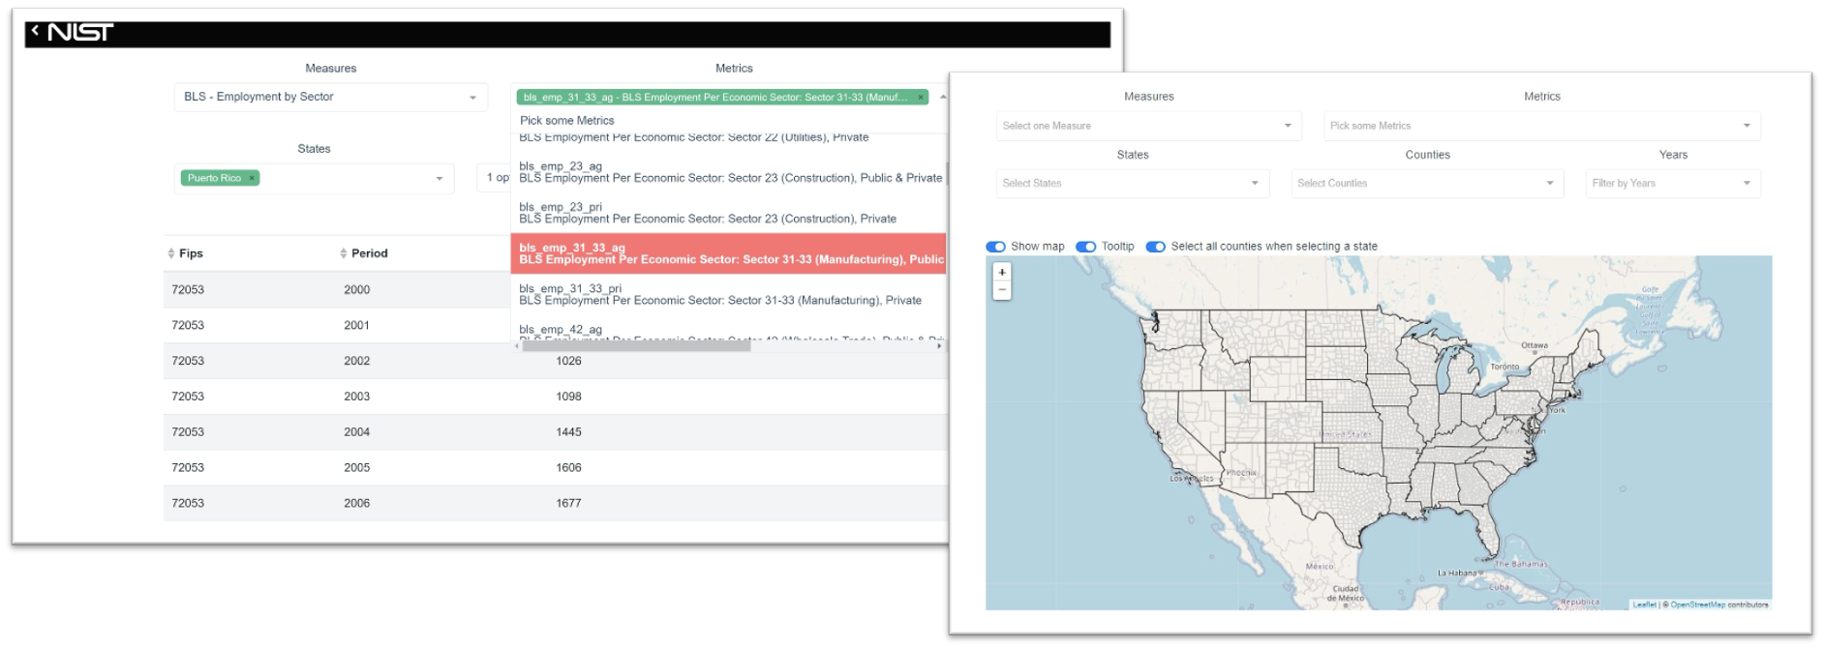
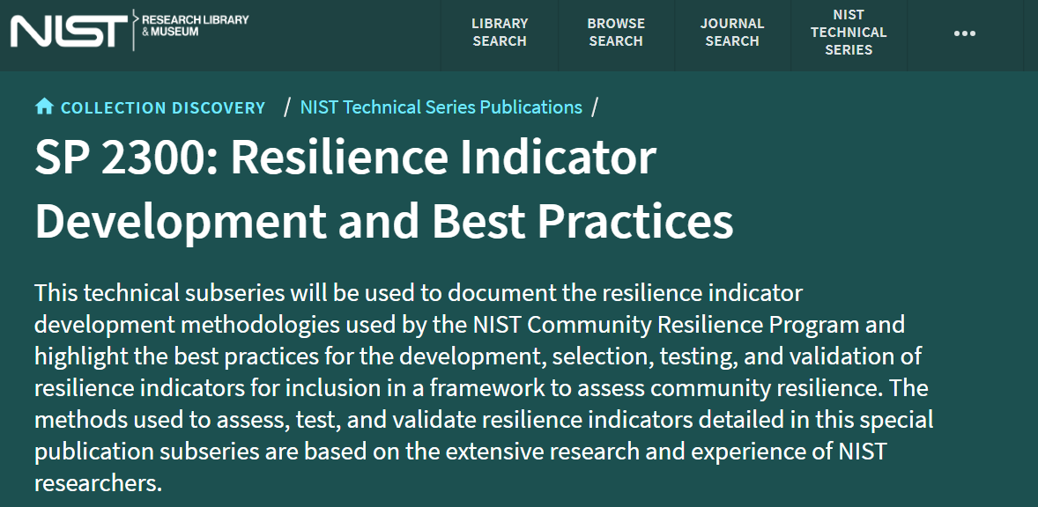
Next Steps
NIST’s recommended list of indicators and measures included in the TraCR Database
NIST publication series: generalized guidance on predictive indicator development and validation testing
Collaborations with federal institutions and local municipalities
Notes:
The use of indicators has been slow, partially because of a lack of clarity on how to select appropriate indicator sets.

Slide 24
SRA Session Later Today
“An expert judgment process for improving the scientific credibility of resilience indicator selection”
W3-A: Advances in Risk and Resilience Practice 1:30 PM - 3:00 PM
Today at 2:30 PM - 2:50 PM
River Birch Ballroom A
Criterion Validity
Construct Validity
Resilience
Outcomes
Predictive Indices
Indicator Selection and Validation
(Gu et al., 2023)
(Gu et al., 2025)
(Gu et al., 2026)
Translational Validity
Content
Validity
Indicator Taxonomy
Quality of
Evidence
(Gerst et al., 2025)
(Gerst et al., 2024)
(Gerst et al., 2025)
In Progress
Completed

Slide 25
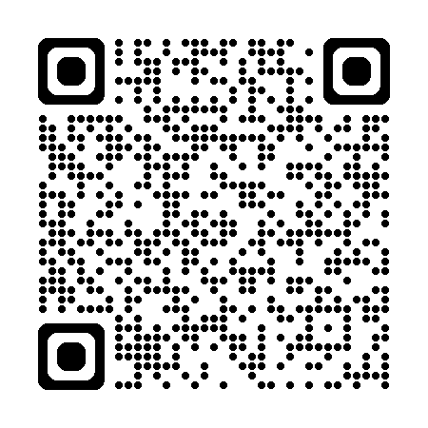
Community Resilience Measurement Project Team
Assessment Products
and more!
https://www.nist.gov/community-resilience-assessment-methodology

