Slide 1
The Case for Innovations in Photovoltaics: The Nanomaterial Edge
Yaw Obeng
Senior Scientist
Semiconductor Electronics Division
Physical Measurements Laboratory
and
Kathleen Richardson
School of Material Science and Engineering
Clemson University, Clemson, SC 29634
Official contribution of the National Institute of Standards and Technology; not subject to copyright in the United States.
Certain trademarks are identified in this paper to foster understanding. Such identification does not imply recommendation or endorsement by the National Institute of Standards and Technology.
Notes:
Metrology is the bridge linking a new discovery with the detailed scientific understanding needed to turn the new discovery into useful knowledge and applications.
Lord Kelvin, the preeminent scientist of the late 19th century, knew this one hundred years ago, and it is even more true today
S&T have opened up new worlds that Kelvin did not even dream about, such as quantum mechanics, solid state physics, sub-atomic physics, molecular biology and biotechnology, information technology…
NIST’s unique mission is to support industry and general quality of life through measurements, standards, and technology (metrology infrastructure)
NIST’s unique role in the National Nanotech Initiative is to provide the national metrology infrastructure needed to make nanoscience discoveries into technologies and products that affect people’s lives and the economy.

Slide 2
The Case for Innovations in Photovoltaics:
The Nanomaterial Edge
Abstract
The limitations of current thin film and the gaps to cost efficient photovoltaic (PV) cells will be discussed in the presentation. This discussion will suggest ways to improve PV cell performance through the use of reduced dimension materials (e.g., nanomaterials). The discussions will be illustrated with the use of plasmonics to concentrate light and trap light in semiconductor thin films. Recent results from our work to engineer the special density and aspect ratios of noble metal nanoparticles in dielectric thin films will be discussed.
References:
Nature Materials, 9 (2010, 205
Massera, J et al., Materials research Bulletin 43 (2008), 3130
Massera, J. eta al, Journal of Physics and Chemistry of Solids, 71 (2010), 1634
Invited Talk to be presented at the
8th Annual Tactical Power Sources Summit, January 24 - 27, 2011 - Crystal Gateway Marriott, Arlington, Virginia
Notes:
Metrology is the bridge linking a new discovery with the detailed scientific understanding needed to turn the new discovery into useful knowledge and applications.
Lord Kelvin, the preeminent scientist of the late 19th century, knew this one hundred years ago, and it is even more true today
S&T have opened up new worlds that Kelvin did not even dream about, such as quantum mechanics, solid state physics, sub-atomic physics, molecular biology and biotechnology, information technology…
NIST’s unique mission is to support industry and general quality of life through measurements, standards, and technology (metrology infrastructure)
NIST’s unique role in the National Nanotech Initiative is to provide the national metrology infrastructure needed to make nanoscience discoveries into technologies and products that affect people’s lives and the economy.

Slide 3

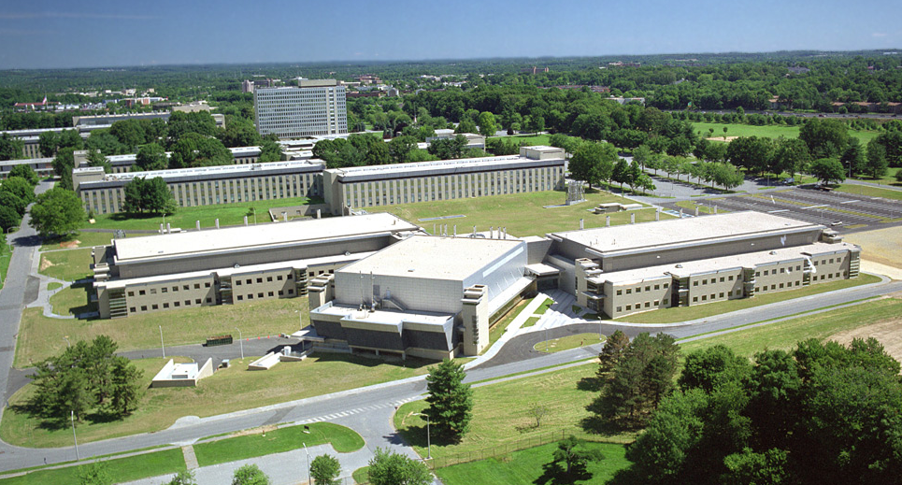

A National Laboratory of the
U.S. Department of Commerce
3,000 employees
1,550 guest researchers
1,200 industrial partners
$800 million annual budget
$1.4 billion co-funding of
industry R&D
National measurement standards
Large-facility infrastructure:
  NIST Center for Neutron Research
  Synchrotron Measurement Science Group
  Nanofabrication facility
NIST campus in Maryland near Washington DC
Established 1901

Slide 4
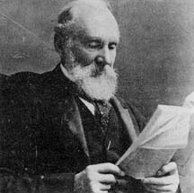
We Measure Stuff
The science of measurement; a system of measures
“When you can measure what you are speaking about, you know something about it. But when you cannot measure it, your knowledge is of a meager and unsatisfactory kind. It may be the beginning of knowledge, but you have scarcely advanced to the stage of science.”
William Thomson, Lord Kelvin
Notes:
Metrology is the bridge linking a new discovery with the detailed scientific understanding needed to turn the new discovery into useful knowledge and applications.
Lord Kelvin, the preeminent scientist of the late 19th century, knew this one hundred years ago, and it is even more true today
S&T have opened up new worlds that Kelvin did not even dream about, such as quantum mechanics, solid state physics, sub-atomic physics, molecular biology and biotechnology, information technology…
NIST’s unique mission is to support industry and general quality of life through measurements, standards, and technology (metrology infrastructure)
NIST’s unique role in the National Nanotech Initiative is to provide the national metrology infrastructure needed to make nanoscience discoveries into technologies and products that affect people’s lives and the economy.

Slide 5
NIST Core Roles
measurements and standards
  methods
  techniques
  instruments and tools
  reference materials
  traceability
critically evaluated data
  foundation for models and simulations
    predict properties and function of materials
    scaleable models
  tools for validation
Notes:
re-characterization of roles
essential to note, that our core roles both provide a foundation for nanoscience to build upon –
measurements & data & models will enable and accelerate development and adoption of technology
though more pedestrian, at the least, our measurements, standards, data and models will serve as benchmarks and fill needs for quality control.

Slide 6
The Energy Challenge
Global Energy Resources:
  Economic growth and expanding population will double the world’s demand for energy by 2050 and triple it by the end of the century, even with aggressive conservation efforts. Current usage is 13 TW.
  The threat of climate change imposes requirements on future energy sources.
  Three prominent options:
    Fossil fuel use with carbon sequestration
    Nuclear power
    Renewable energy resources:
      hydroelectric, tides and ocean currents, geothermal, wind, and solar
Solar Energy:
  More energy from sunlight strikes the earth in 1 hour (4.3 x 10²⁰J) than all the energy currently consumed on the planet in a year (4.1 x 10²⁰J).
  Sunlight is readily available, free from geopolitical tension and not a threat to the environment through pollution or to the climate through greenhouse gas emissions.
  However, solar energy is diffuse and intermittent; effective collection, storage, and distribution are critical to matching supply with demand.
6
Notes:
(4.1 x 1020J/year is 13 TW)
Of the three prominent options:
Fossil fuel use with carbon sequestration is currently undemonstrated and issues with finding storage volumes and preventing leakage remain
Nuclear power - producing 10TW would require the construction of a nuclear fission plant somewhere in the world every other day for the next 50 years
Renewable energy resources:
hydroelectric:U.N estimates less than 0.5 TW exploitable
tides and ocean currents: less than 2 TW
geothermal: total at the surface/land area of the Earth is 12 TW; only a fraction could be extracted
wind:IPCC estimates 2-4 TW
solar: hitting the top of the atmosphere is 170,000 TW, 120,00 TW is not scattered by atmosphere and clouds and strikes the Earth
In the U.S. a net 10% energy farm covering 1.6% of the U.S. land area would meet the country’s domestic energy needs; 0.16% of the land on Earth would supply 20 TW of power globally – this is equal to 20,000 1-GWe nuclear fission plants.
20,000 nuclear power plants would have to be constructed by the second half of the 21st century if carbon sequestration doesn’t work and solar energy is not developed.

Slide 7
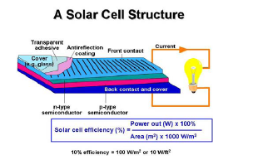
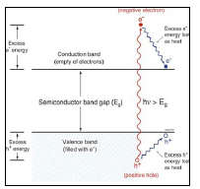
The Basic Ideas of PV

Slide 8
…Fix The Gaps for Improved PV Systems
Engineered materials
Integration
Manufacturability
Reliability
Storage
ESH (Make it green)
We Need New and “Out of The Box” Innovations

Slide 9
Cost Reduction
worldwide electricity consumption of 17 000 TWh, of which nine have the potential for a significant cost reduction over crystalline silicon. We identify a large material extraction cost (cents/watt) gap between leading thin film materials and a number of unconventional solar cell candidates including FeS₂, CuO, and Zn₃P₂. We
worldwide electricity consumption of 17 000 TWh, of which nine have the potential for a significant cost reduction over crystalline silicon. We identify a large material extraction cost (cents/watt) gap between leading thin film materials and a number of unconventional solar cell candidates including FeS₂, CuO, and Zn₃P₂. We
worldwide electricity consumption of 17 000 TWh, of which nine have the potential for a significant cost reduction over crystalline silicon. We identify a large material extraction cost (cents/watt) gap between leading thin film materials and a number of unconventional solar cell candidates including FeS₂, CuO, and Zn₃P₂. We
Worldwide electricity consumption of 17000 TWh,
The Information Network, recently published a report projecting that the nanomaterials for solar cells industry was expected to grow by 44 percent in 2009, after a growth rate of 47 percent in 2008.
MNP Enables the Use of Unconventional solar cell material candidates include:
FeS₂,
CuO,
Zn₃P₂.
Materials Availability Expands the Opportunity for Large-Scale Photovoltaics Deployment Cyrus Wadia, A. Paul Alivisatos, Daniel M. Kammen
Environmental Science & Technology 2009 43 (6), 2072-2077

Slide 10
Why are Current PV Cells Inefficient?

Slide 11
We Don’t Have Enough Raw Materials to Support PV Needs

Slide 12
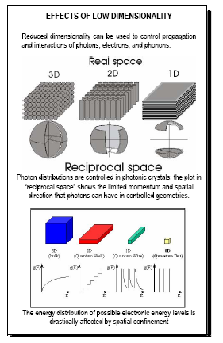
Reduced Dimensionality
ORGANIC PV MATERIALS

Slide 13
Metal Manoparticles in PV Applications
Electromagnetic scattering by metal and semiconductor results in substantial increases in power transmission into the semiconductor substrates.
  Increases in power conversion efficiency under simulated solar irradiation of up to 8.8%
Plamosnic light trapping enhances the efficiencies of thin film solar cells
  The aspect ratio of the meal nanoparticle is critical for enhanced efficiencies.
Can we manipulate the distribution an the aspect ratios of these metal nanoparticles?

Slide 14
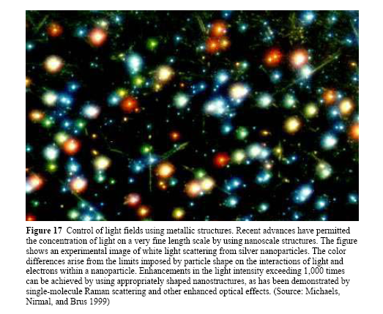
Enhance Light Intensity With Metal Nanoparticles
ORGANIC PV MATERIALS

Slide 15
Tune Light Absorption with MNP and Dielectrics

Slide 16
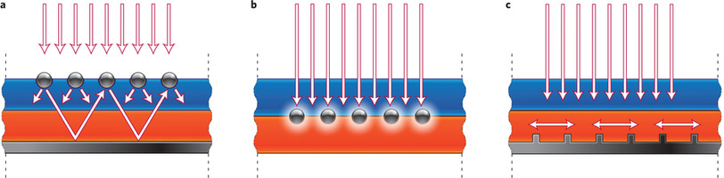
Plasmonic Light-Trapping Geometries for Thin-Film Solar Cells.
Nature Materials 9,, 205–213, (2010)

Slide 17
Engineer MNP For PV Applications: Aspect Ratios are Critical

Slide 18
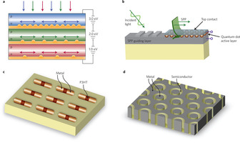
New Plasmonic Solar Cell Designs
Nature Materials 9,, 205–213, (2010)

Slide 19
Tops Down Plasmonics Manufacturing at the Wafer Level

Slide 20
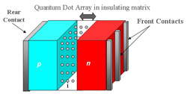
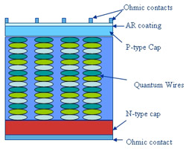
Nanomaterials and Nanostructures for Space Photovoltaics
A PV cell with a single intermediate electronic band created by a layer of nanometer-sized semiconductor crystals (quantum dots) inserted into the i region of an ordinary p-i-n junction solar cell offers a conversion efficiency of 63.2%.
While two intermediate bands have been predicted to have a limiting efficiency of 7l.7%.
Bonus:
Multiple quantum well photovoltaic devices have demonstrated improved radiation tolerance and temperature coefficients
http://rt.grc.nasa.gov/power-in-space-propulsion/photovoltaics-power-technologies/technology-thrusts/nanomaterials-and-nanostructures-for-space-photovoltaics/

Slide 21
Bottoms-Up Engineering of MNP in Dielectric Matrices

Slide 22
Formation of Cu-based nanoparticles
Transmission spectra of Cu doped SiO₂ (x=0.05)
30 minutes of stirring in Ambient Light
Heat Treated for 6 hours at 550ºC in H₂
↓ transmission properties
Absorption band at ~440nm*
From colorless to brownish
↓ transmission properties
Absorption band at ~580nm*
Absorption band related to Cu₂O nanoparticles*
Probable light induced oxidation
Absorption band related to Cu nanoparticles**

Slide 23
Effect of Post Irradiation Heat Treatment (in Air)
 | cw | ns
Irradiation Time Dose | 24 hrs 450J/cm² | 30 min ~1500J/cm²
Band Intensity ⇒Nanoparticle Number | + | ++
Band Width ⇒Size distribution | - | -
Band Shift ⇒nanoparticles size | - | --
Larger quantity of Au nanoparticles using UV Nanosecond exposure
→ probably due to higher dose
  ⇒ Increase in color center formation
Notes:
How will you assess the fact that you are not actually measuring these items in the left hand column of your table?
Is this certain that there is color center formation?

Slide 24
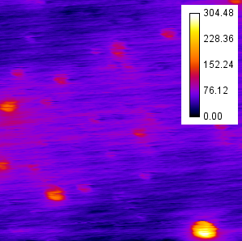
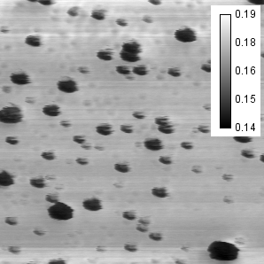
Map of the Relative Heat Flow
Cu MNP Doped SiO₂ ₂ films
Topography and heat flow
Un-doped SiO₂ films
Topography and heat flow
Q
Z (nm)
Q
Q
x=0 x=0.005 x=0.05
Q=0.17±0.01 Q=0.17±0.01 Q=0.17±0.01
No variation of relative heat flow with progressive incorporation of NMP, though additional roughening of Silica film morphology
Notes:
Note additions on topography increase……
Did you verify that this indeed was a SiO2 cluster? If yes, how (insert as XXX), if not, change caption to say “presumed to be”

Slide 25
Conclusion and Perspectives
Formation:
Cu₂O formed by probable light induced oxidation
Cuº nanoparticles formed only by heat treatment in H₂,
Ag & Au nanoparticles formed using heat treatment in air and H₂, improvement Au nanoparticles formation using UV light exposure
Dissolution:
Cu₂O dissolved using UV light exposure
Cu-based nanoparticles dissolved by heat treatment
Ag and Au nanoparticles dissolved by IR femtosecond exposure
Formation/dissolution:
Spatially selective writing of metallic lines
Electrical conductivity of the lines
Extend this study to other metallic systems
Notes:
Changed font!!!

Slide 26





Imagine ……………………………………..
Thank You
What
if?

