Slide 1
Early LNG Program and LN₂ Cryogenic Flow Measurement Facility at NIST
Dan Friend and Mike Lewis
Thermophysical Properties Division
Material Measurement Laboratory
National Institute of Standards and Technology
Boulder, CO (USA)
LNG Metrology Workshop
9 November 2010
Stockholm, Sweden

Slide 2

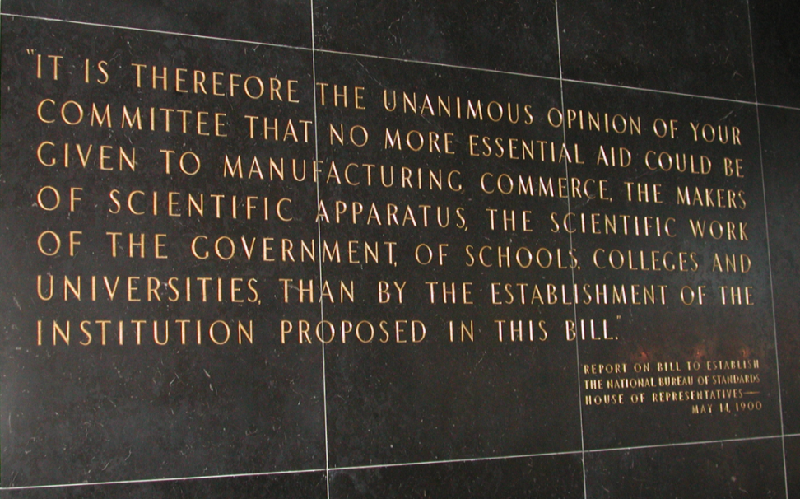
National Institute of Standards and Technology (NIST)
NIST is the National Metrology Institute (NMI) for the U.S., and signatory to the CIPM MRA
Non-regulatory
agency within
U.S. Department
of Commerce
Founded in 1901 as
National Bureau of
Standards
Article I, Section 8: The Congress shall have the power to …coin money, regulate the value thereof, and of foreign coin, and fix the standard of weights and measures
Mission …
to promote U.S. innovation and industrial competitiveness by advancing
measurement science, standards, and technology
in ways that enhance economic security and improve our quality of life
Apr 2010
Aug 09
Notes:
2
2
Constitution – 1787 – gave the Congress the authority to create relevant standards

Slide 3
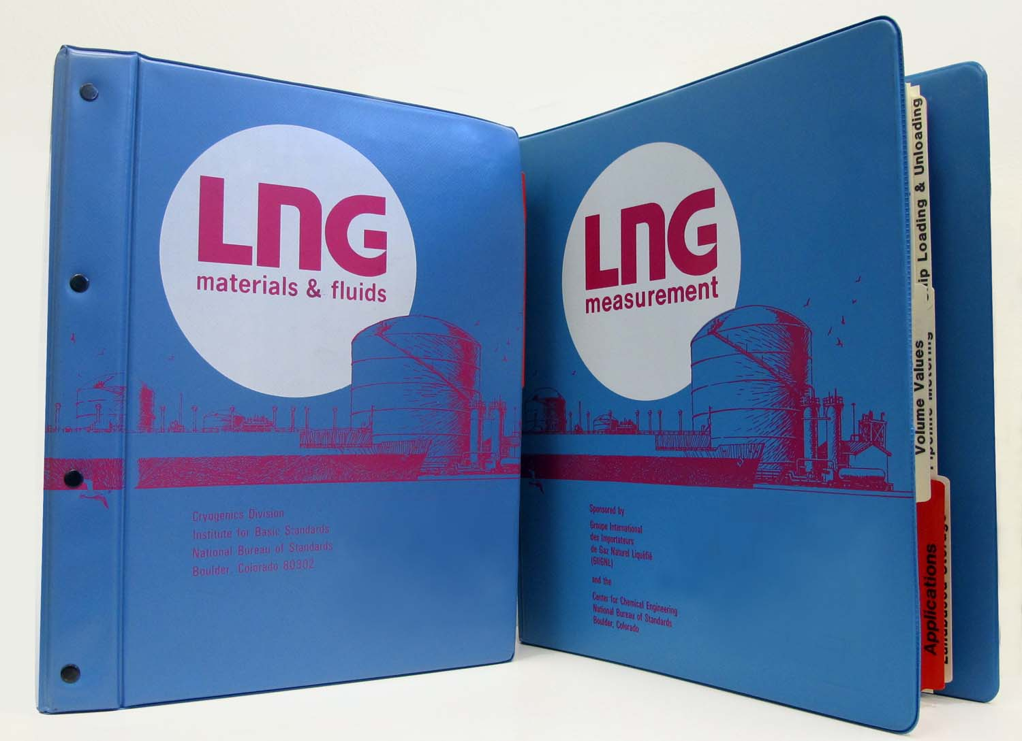
LNG at NIST (NBS):1970 to 1985
Sponsors and Collaborators
Groupe International des Importateurs de Gaz Naturel Liquéfié
American Gas Association
Gas Research Institute
DOC Maritime Administration
American Bureau of Shipping
…
Western LNG Terminal Assoc.
Tokyo Gas Co.
Columbia LNG Corp.
El Paso LNG Co.
Ruhrgas LNG
…

Slide 4
LNG Materials and Fluids
Materials
  Structural Materials: Aluminum Alloys; Invar; Nickel Steels, …
  Thermal Insulators: Polystyrene; Polyvinyl Chloride; Balsa, …
  Concrete: Elastic (Young’s Modulus); Thermal; Mechanical
  Nonmetallic Laminates: Cotton fabric/phenolic; glass mat/epoxy
Fluids
  Pure Fluids: methane, ethane, … (charts, etc.)
  Fluid Mixtures: LNG mixtures, binary mixtures
See: Cryogenic Material Properties Database (NIST SRD #152)
http://www.cryogenics.nist.gov/MPropsMAY/materialproperties.htm
NIST Chemistry WebBook (NIST SRD #69)
http://webbook.nist.gov/chemistry/
NIST REFPROP (NIST SRD #23)
http://www.nist.gov/srd/nist23.cfm

Slide 5
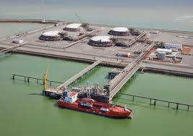
LNG Measurement
A User’s Manual for Custody Transfer (1985)
Section 1
Physical Properties
  SI System
  Pure Fluid Properties
  Combustion Enthalpies

Slide 6
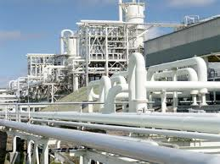
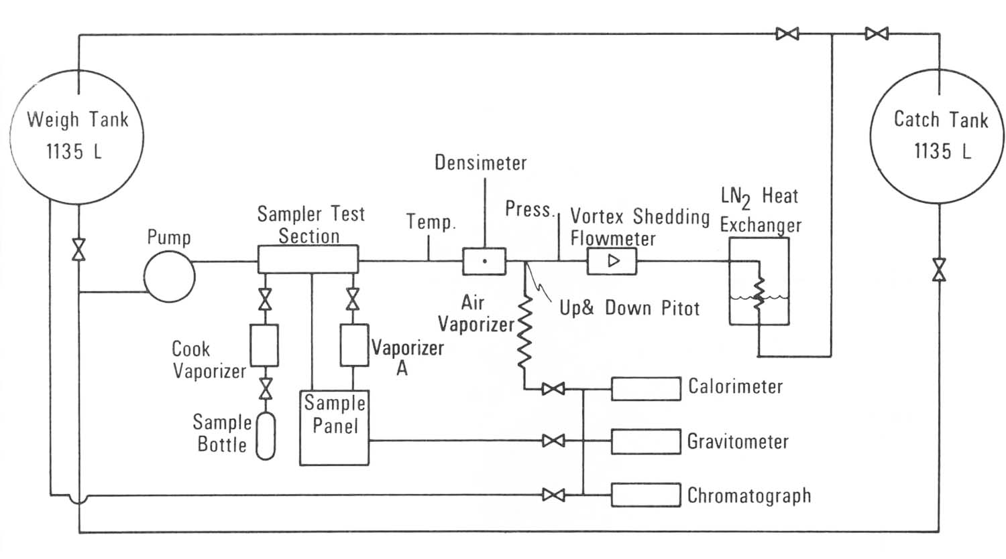
LNG Measurement
Measurement Elements
  Measurement Process Applied to LNG
  Sampling and Analysis
    Sample probe (pitot, side tube, …)
    Sample conditioner (vaporizing)
    Gas analyzer (GC, MS, integrator, packings, etc. )
    Operating parameters/procedures
Laboratory tests
LNG Flow Loop
Shipboard Tests (at Canvey Island,
England)
U(3σ, heating value) = 0.3 %

Slide 7
LNG Measurement
Measurement Elements
  Calorific Value: calorimeters, calculations, comparisons
  Density Values:
  Cryogenic density reference system—calibrations of LNG densimeter transfer standards U (LCH4) = 0.055 %
  Portable Reference Densimeter—tests of commercial LNG densimeters
  Experimental LNG Density—NBS densimeters; pure fluids; binary mixtures, multicomponents (NBS Monograph 172, 1983)
  Mathematical Models for LNG Densities—ECS, HS, Klosek & McKinley (r), cell
See: ASTM D4784 – 93 (2010) Standard Specification for LNG Density Calculation Models
GERG EOS (2004)
NIST REFPROP (NIST SRD #23) http://www.nist.gov/srd/nist23.cfm

Slide 8
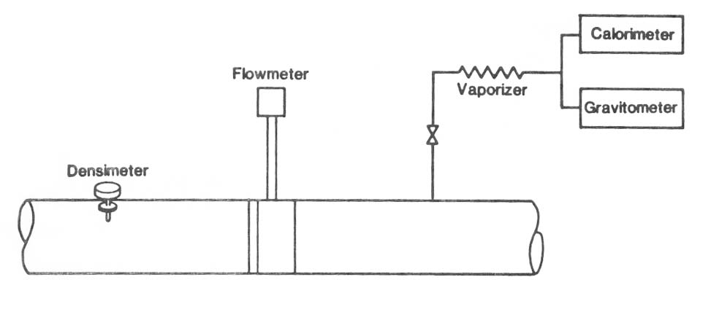
LNG Measurement
Measurement Elements
  LNG Volume
  Liquid Level Measurement: capacitance gauges, cable gages, bubbler gauges
  Volume of Membrane-Type LNG Ship Tanks U = 0.1 %
  Volume of Freestanding Prismatic LNG Ship Tanks U = 0.1 %
  Volume of Spherical LNG Ship Tanks
  Volume of Cylindrical LNG Shore Tanks U = 0.005 %
  Volume from Totalized Flow Rate Metering
    LNG Measurement Station: flowmeter, densimeter, calorimeter, gravitometer
  5 cm to 81 cm (2 in to 32 in) flow meter scaleup

Slide 9
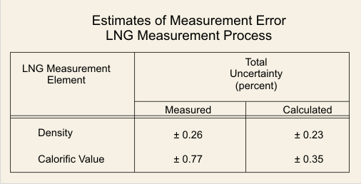
LNG Measurement
Applications
  Measurement Uncertainties: volume, gas analysis (0.09 %), calculated LNG density (0.23 %), measured density (0.26 %), calculated calorific value (0.77 %), measured calorific value (0.77 %)
  Ship Loading/Unloading (0.2 % to 0.4 % calorific value)
  Pipeline Metering (0.65 % to 0.95 %)
  Landbased Storage (0.34 % to 0.65 %)

Slide 10
NIST Cryogenic Flow Measurement Facility
Testing and Calibration Services

Slide 11
Why LN2 Calibrations?
LN2 vs Water Calibrations

Slide 12
Capabilities
Flow Rate
Mass : 0.95 to 9.5 kg/s
Volume : 1.26 to 12.6 L/s
Absolute Pressure
0.4 to 0.76 MPa
Temperature
80 to 90 K

Slide 13
Metering Characteristics
Meter Test Section Design
  25 to 150 mm diameter
  4 meter length
Flowmeter Calibration Services
  Turbine
  Coriolis
  Ultra Sonic
  Vortex shedding
Research Application
  Prototype meter testing
  Meter verification at LN2 temperatures
All measurements are traceable to national standards

Slide 14
NIST Quality System and Conformance to ISO/IEC 17025
NIST Quality System in place
Website: http://www.nist.gov/qualitysystem/
NIST Quality Assessment
NIST Assessment Review Board
NIST Measurement Services Advisory Group (MSAG)
SIM Regional Metrology Organization
QSTF: Quality Systems Task Force
BIPM: Bureau International des Poids et Mesures
CIPM: International Committee for Weights and Measures/ Comité International des Poids et Mesures
MRA: Mutual Recognition Agreement
CMC: Calibration and Measurement Capabilities
Inclusion in Appendix C Calibration and Measurement Capabilities

Slide 15
Facility Components and design
Liquid nitrogen flow
  Closed loop
Mass Measurement
  Load cell
  Weigh tank
Subcooler
  Remove thermal energy
Temperature measurement
  PRT’s
Pressure measurement
  Pressure transducer

Slide 16
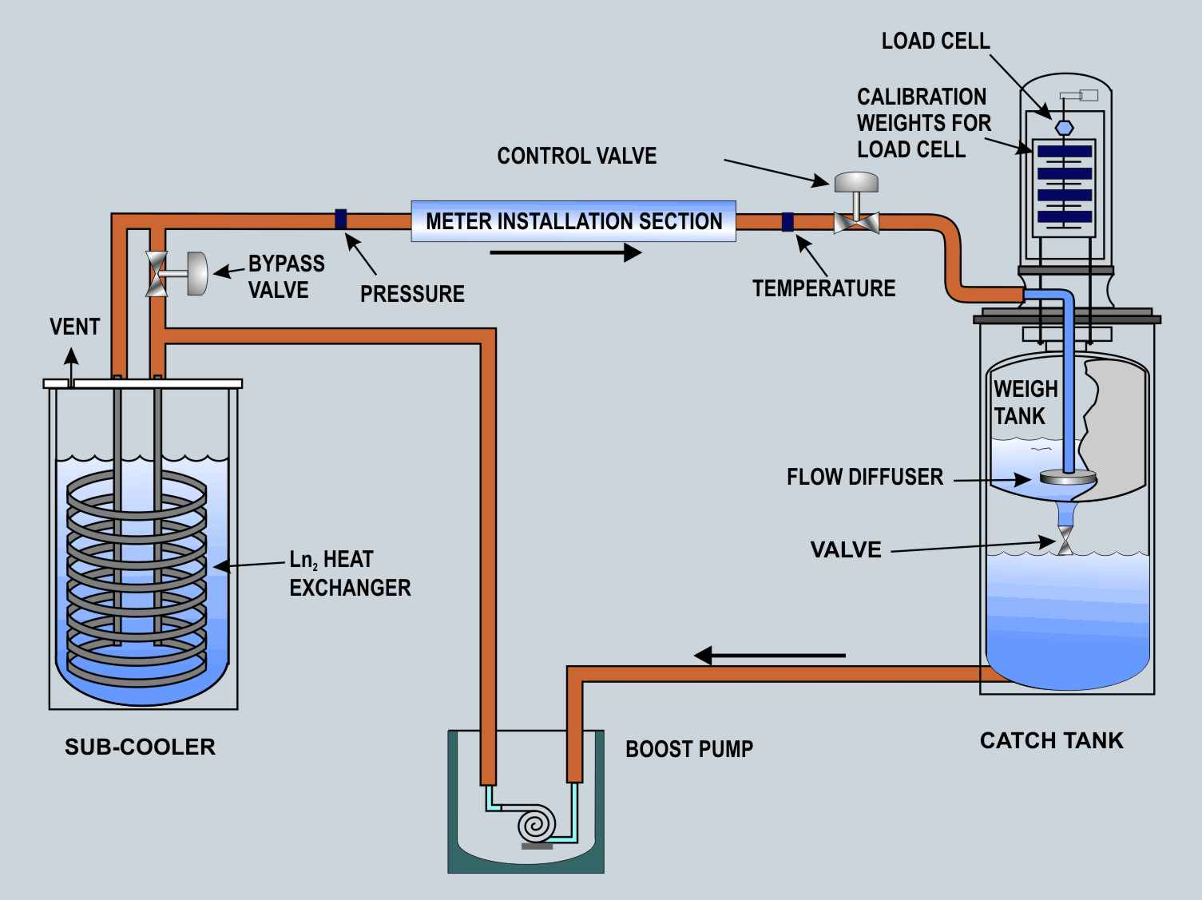
Liquid Nitrogen Flow Facility Schematic

Slide 17
Facility Description
Liquid nitrogen is the process fluid
Circulated throughout the closed loop by a variable speed pump
Flows into a subcooler where thermal energy is removed
  due to pumping
  ambient heat leak
Temperature in the test section controlled by
  adjusting the subcooler liquid level
  diverting flow around the subcooler
  an inline heater
Pressure in the test section controlled by
  Downstream control valve
  Introducing helium gas pressure

Slide 18
Nitrogen Flow Procedure
Catch tank liquid volume creates positive head pressure on centrifugal pump
  Prevents cavitation and bubbling
Fluid circulates in 76.2 mm vacuum-jacketed copper pipeline
Liquid flows into diffuser to remove vertical component of velocity at bottom of aluminum weigh tank
  0.378 m³ capacity
Liquid flows through valve at bottom of weigh tank and into stainless steel pressure vessel
  0.443 m³ capacity
When temperature, pressure, and flowrate reach steady-state condition
  weigh tank valve closed
  System timers and data acquisition begin
  Predetermined amount of liquid nitrogen accumulates in weigh tank
  Varies from approx. 440 kg to 1320 kg
Mass collected for each data point is determined by
  Load cell output voltage values
  Total time the mass was collected

Slide 19
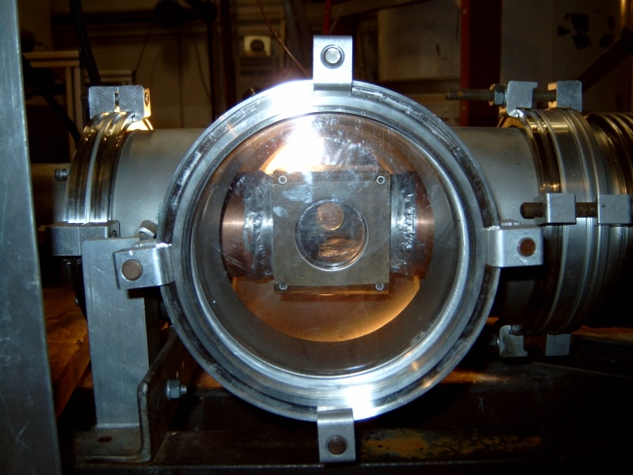
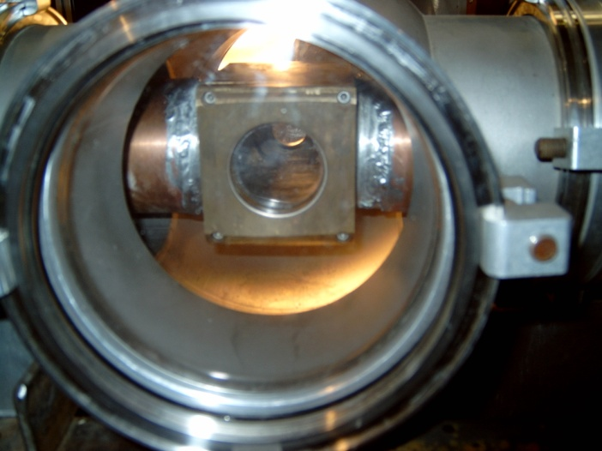
Liquid Nitrogen Flow Stream
Sapphire window provides ability to observe flow directly downstream of flowmeter test section prior to entering weigh tank
Internal liquid line is vacuum-jacketed to clearly view flow stream for gas bubbles

Slide 20
Data Acquisition
Once liquid level reaches preset value, test point begins
Timer is initiated and data acquisition begins
Frequency output from flowmeters is input into counters to totalize meter pulses
Pressure and temperature are measured for density calculations in meter test section as well as in weigh and catch tanks for buoyancy calculations and system monitoring

Slide 21
Uncertainty in Liquid Nitrogen Mass Flow Measurement
Components of the mass flow uncertainty
  Load cell sensitivity measuring the mass of the LN2
    Weights
    Voltage
    Sensitivity equation
    Pressure
  Buoyancy evaluated for each mass measurement
    Buoyancy of LN2 accumulated during the data point
    Buoyancy of the immersed diffuser and pipe in LN2
    Change in buoyancy of LN2 accumulated before the data point begins
  Time measurement
    Multi-function datalogger used to measure within 1 ms
  Mass balance between test section and weigh tank
    Finite volume of LN2 in piping between meter and weigh tank
    Provided density gradient in pipe remains constant during data point, mass collected in weigh tank is equivalent to mass passing through meter
      Pressure drop remains nearly constant
      Temperature gradient less than 70 mK

Slide 22
Total Uncertainties (1σ) for Mass Measurement
Source of Uncertainty: | Type A (%) | Type B (%) | Combined (%)
Load Cell Sensitivity | 0.050 | 0.002 | .050
Buoyancy Correction | 0.0001 | 0.068 | 0.068
Mass between Test Section and Weigh Tank (liquid N2) | 0.011
Total for Mass Measurement | 0.051 | 0.068 | 0.085
Expanded Uncertainty, k=2 |  |  | 0.170
Time |  | 0.001 | 0.001
Total for Mass Flow Rate | 0.051 | 0.068 | 0.085
Expanded Uncertainty, k=2 |  |  | 0.170

Slide 23
Total Uncertainties (1σ) for Volumetric Flow Rate Measurement
Source of Uncertainty in Liquid Volume Flow | Nominal Values: T=85 K Mass = 182 kg | P = 620 kPa Time = 100 s
 | Type A (%) | Type B (%)
EOS (REFPROP) |  | 0.02
δρ/δT|_{P} | 0.025 | 0.013
δρ/δP|_{T} (P_{Test Section,}Baro) | 0.0002 | 0.0002
Uncert. in mass flow rate | 0.051 | 0.068
Total (in quad) | 0.057 | 0.072
Total (Type A + B, | in quad), k=2 | 0.184

Slide 24
Calibration Procedure
Statistical calibration program developed
  Uses fractional factorial test plan
  Provides ability to separate main effects and low-order interactions from one another
Allows evaluation of meter for sensitivity to
  Pressure
  Temperature
  Flowrate
  Thermal cycling
60 data points taken over two-day period
  5 temperatures
  12 flowrates
  5 pressures

Slide 25
Data Analysis
For volumetric flow rate, predicted performance of meter in measuring flow rate is compared to flow rate determined by facility:
Meter Mass: M_{R} = Pρ / K (1)
Percent Deviation = (M_{R} – M_{NIST}) * 100 / M_{NIST} (2)
Where,
  M_{R} = mass calculated from the flowmeter output
  P = flowmeter output in total pulses
  ρ = liquid density determined from the flow facility temperature and pressure measurements
  K = meter factor in pulses per unit volume
  M_{NIST =} mass determined by the flow facility
For mass flow rate, only second equation is used

Slide 26
Data Analysis
The deviation data are fitted by least-squares method to mathematical model equation:
Dev(%) = A + BQ + CQ² + DQ³ + ET+ FP
  Dev(%) = percent deviation
  T = fluid temperature
  Q = volume flowrate
  P = liquid nitrogen pressure
  A,B,C,D,E,F = coefficients

Slide 27
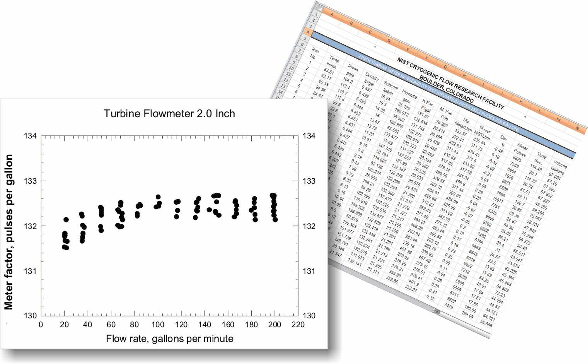
Sample Data Results

Slide 28
Typical Meter Calibration with Statistical Summary

Slide 29
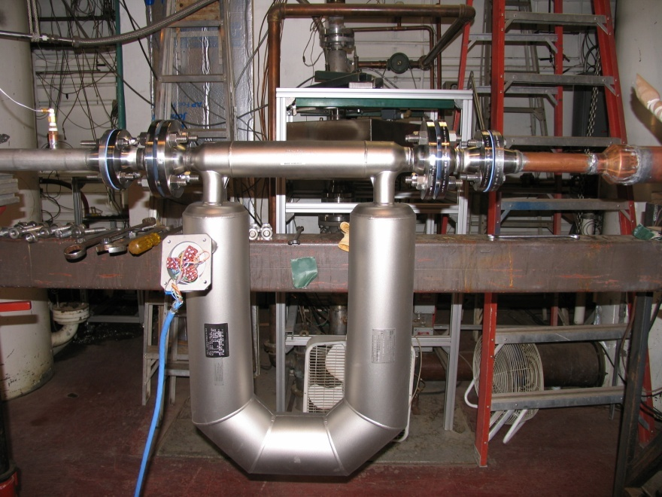
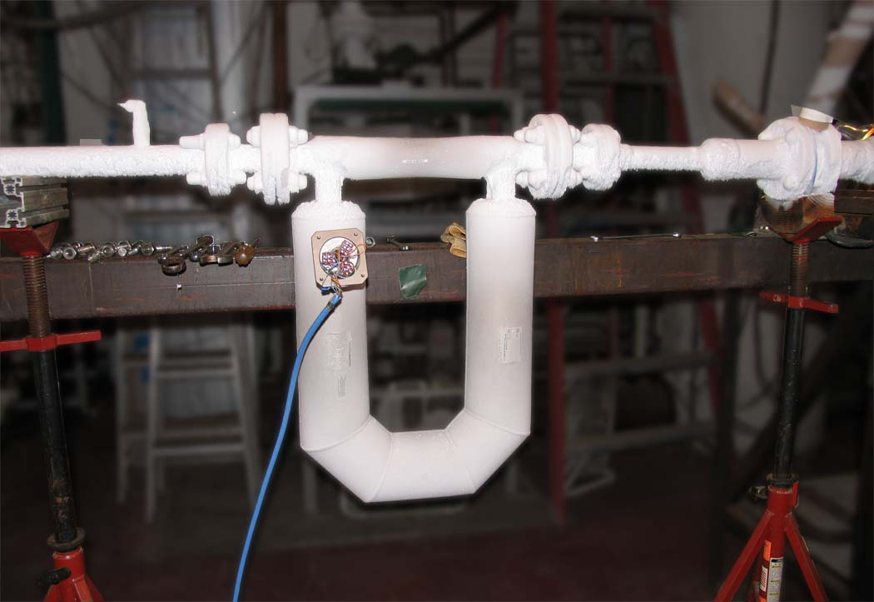
Meter Installation of 38 mm

Slide 30
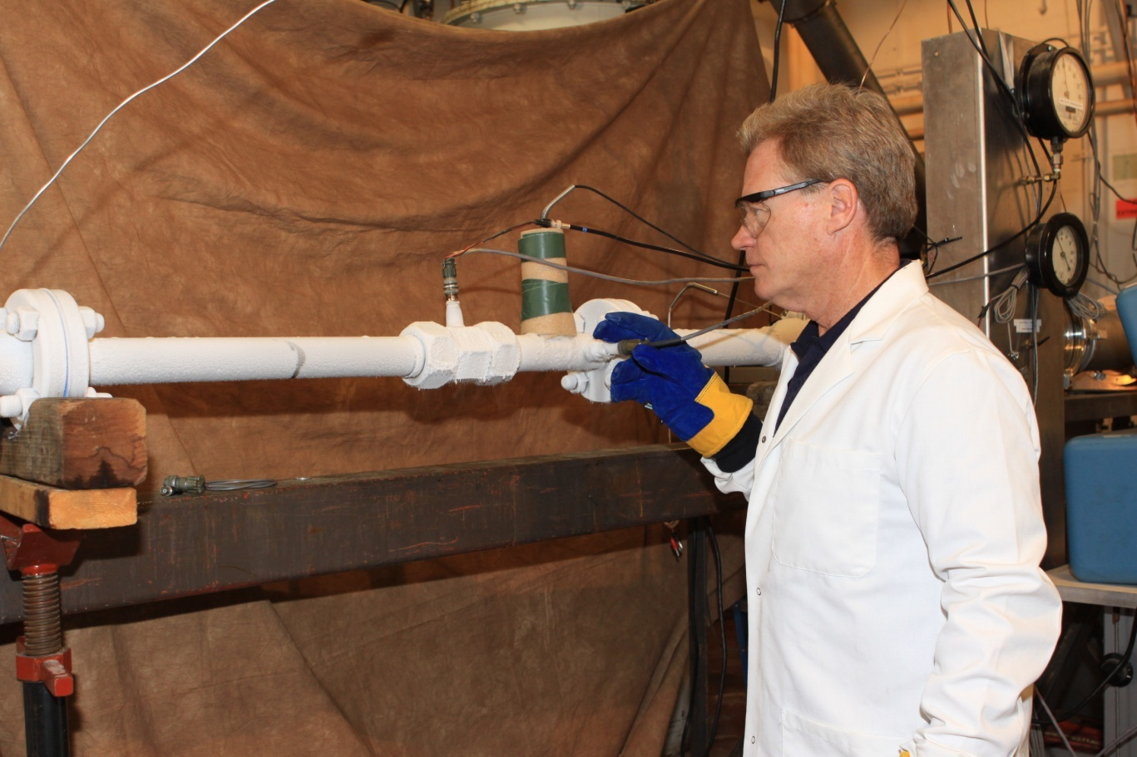
Flowmeter Installation of 50 mm

Slide 31
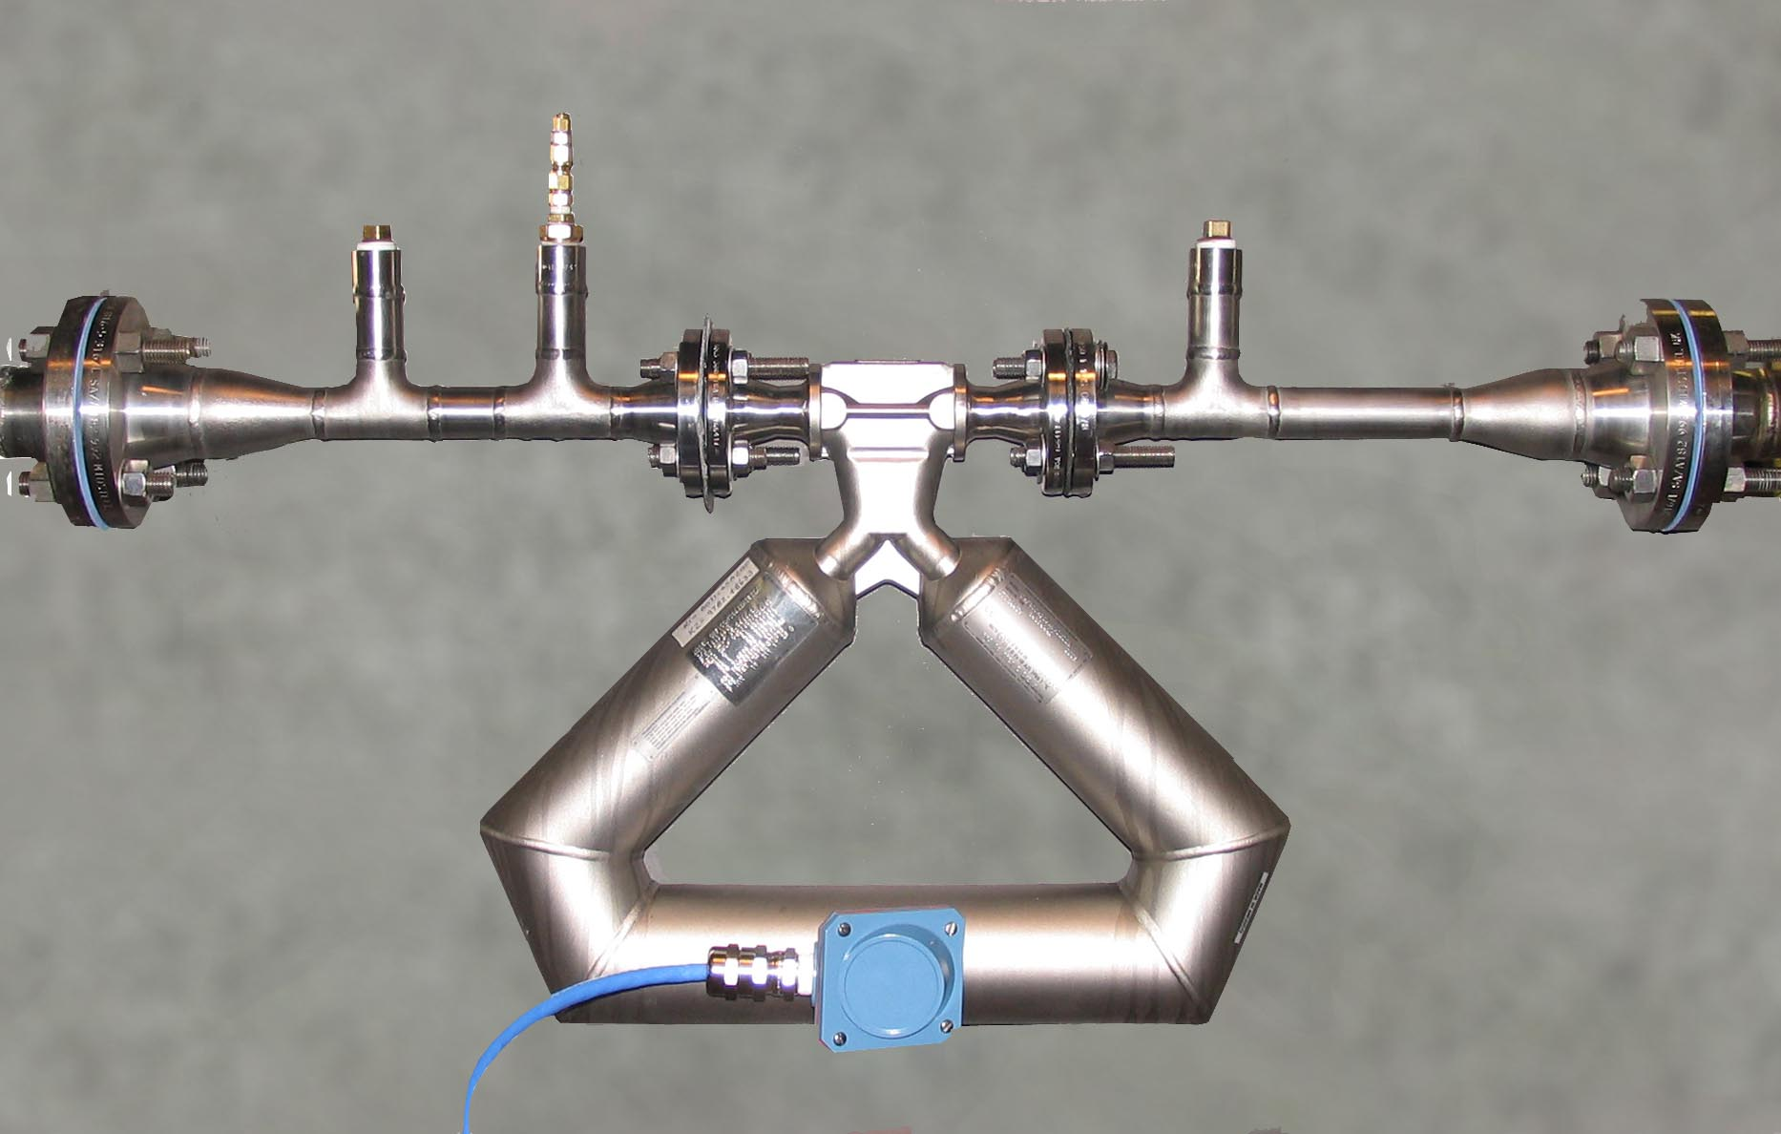
Flowmeter Installation of 25 mm

Slide 32
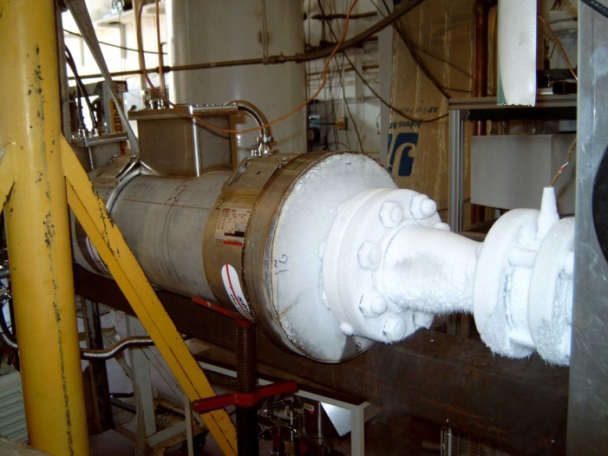
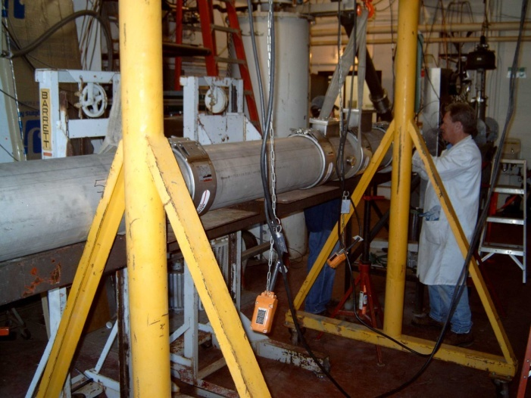
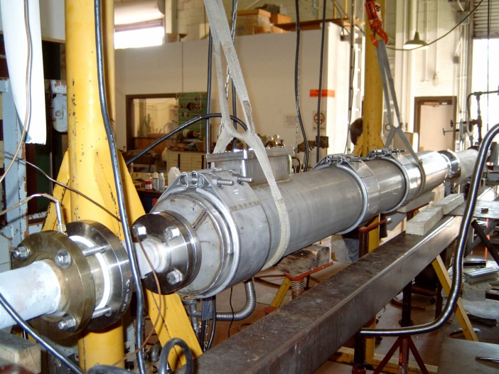
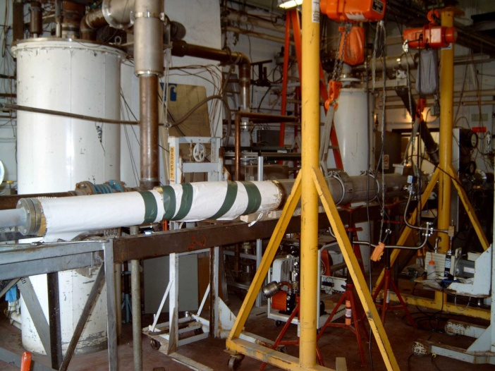
Flowmeter Installation of 150 mm

Slide 33
Summary
NIST Cryogenic Flow Facility is well instrumented in test section and weigh tank/catch tank assembly
A meter evaluation test plan is used to determine sensitivity to pressure, temperature, flowrate, and thermal cycling
Combined expanded uncertainties (k =2) for totalized mass and volume cryogenic flow measurement are 0.17% and 0.18% respectively
Facility has been well used in evaluating various types of flowmetering devices to determine their suitability for measuring cryogenic flows
It is anticipated that LNG and LH2 will have expanding roles as alternative fuels, and NIST will be able to provide assistance in developing accurate measurement methods for cryogenic liquid flows

Slide 34
Thank you for your attention

